Slide 1



Slide 2


Slide 3
The Support
Ensure that your child attends school regularly and on time.
Ensure they attend their Period 6 Intervention Lessons each day.
Talk to your child about their learning, work they have to do and deadlines
Contact your child's tutor if you have any questions or concerns about your child
Attend Parents’ evening
Ensure they have created a Revision Timetable
Check your child’s revision timetable for mock exams which are in January
Check your child’s examination timetable and ensure they understand when their exams take place

Slide 4
The Support
Attend all meetings and workshops organised for parents to assist their children with GCSE work.
Ask your child to go through their test results and projected grade for each subject
Support their organisation by knowing when their exams are and being punctual
Make a Revision Timetable with your child and monitor how they are following it
Praise and encourage
Make sure that your child eats well, takes breaks and sleeps before 11.00pm every night
Observe and talk to your child to ensure their mental well-being
Don't hesitate to contact the school for support, if you need it

Slide 5
Coursework
Students will have many deadlines to meet during this year.
You can help your child by:
Monitoring their coursework. Find out what they have to do and when it has to be handed in
Making sure they are doing some work every evening
Contacting their tutor if they say they have no work to do, or if they are worried about a piece of work
Encouraging them to attend clubs, half-term, Easter, and Saturday revision classes
Buy the relevant study and revision guides
Encouraging them to use the numerous websites available to support their coursework and revision

Slide 6
Practical Support
Provide them with a quiet place to study
Make sure they take regular breaks
Ensure that they eat healthy food and drinks plenty of water
Test them on the work they have been revising or encourage older siblings to test them
Ensure that they go to bed at a reasonable time and gets enough sleep
Monitor and limit the of their mobile phone for social media especially
Ensure that they revise thoroughly for both the mock and final examinations.

Slide 7


Slide 8
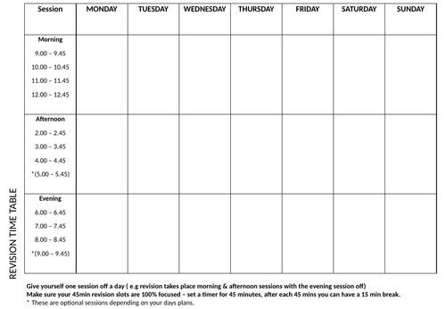
Revision Timetable
Download a template from online.
Create it for evenings and weekends.
Set Revision Goals and Grades.
Prioritise subjects
Colour-code subjects
Break subjects down into topics
Allocate time slots
Schedule breaks e.g. Pomodoro Effect

Slide 9
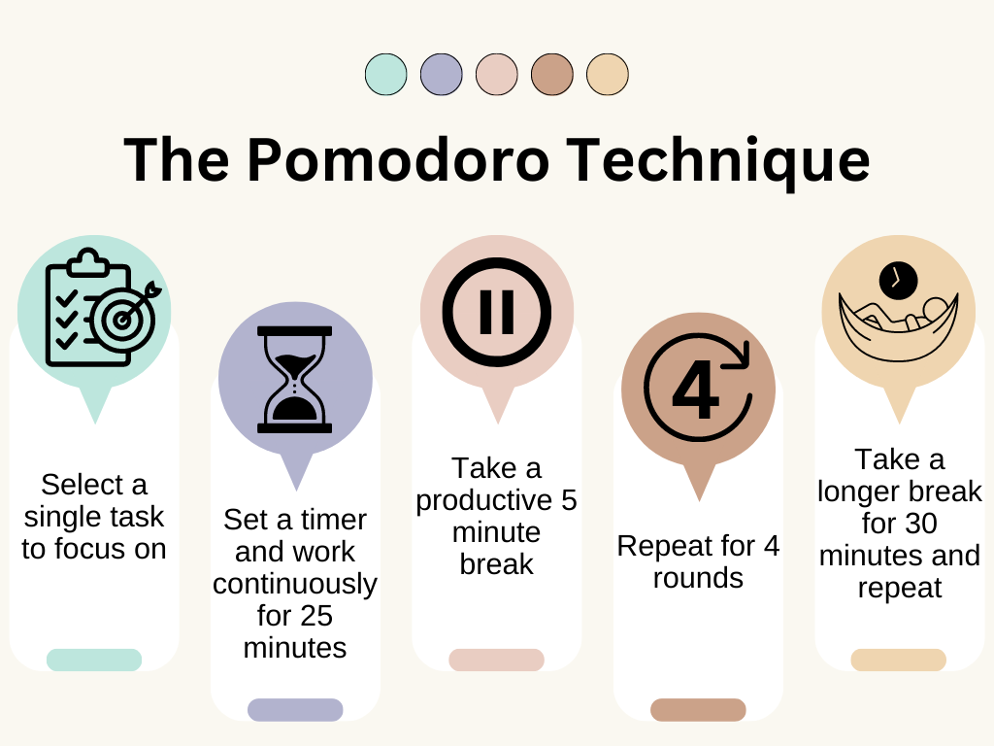

Slide 10
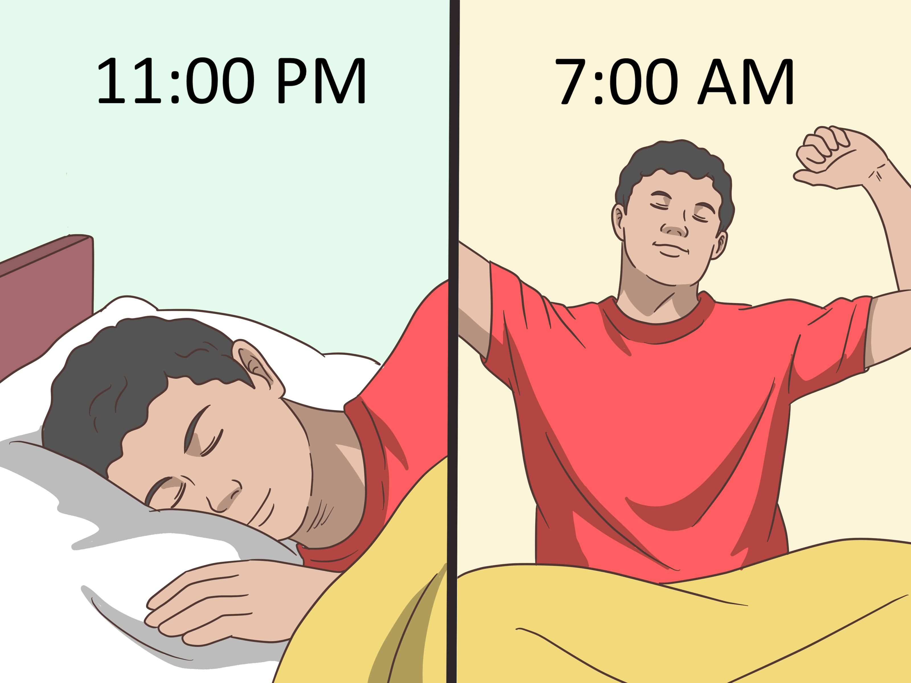


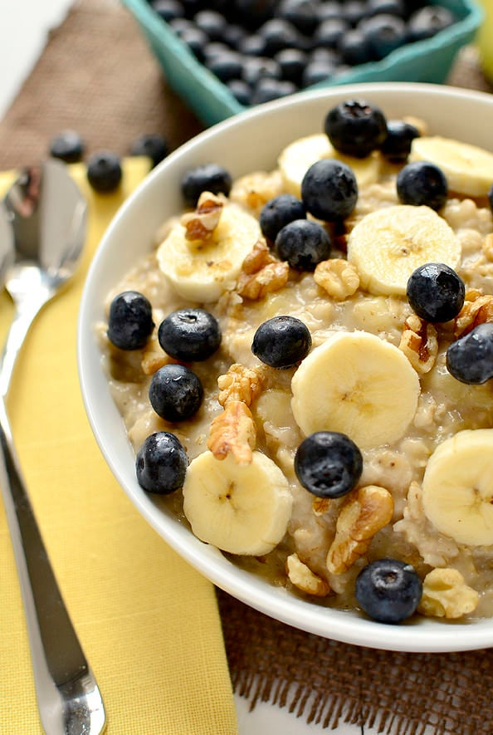


Slide 11
Habits of high performing students
Knowing your strengths and weaknesses
Regular revision sessions (everyday)
Bite size revision or chunks
Have a Goal in mind and visualise
Learn how to motivate yourself and Growth Mindset
Study environment
Time your study
E.g. 25-minute bursts (Pomodoro Technique)
Keep on top of Homework
Ask your teachers for help
Past papers and markschemes
Quizzes
Explain it to someone else
Draw diagrams
Mind Maps
Brain Dumps
Revision Clocks
Work on your shortcomings
YouTube/Videos
Seneca
Key Vocabulary
Make voice recordings
Memorise facts – look/cover/write
Rhymes / pneumonic
Flash cards (Leitner System)

Slide 12
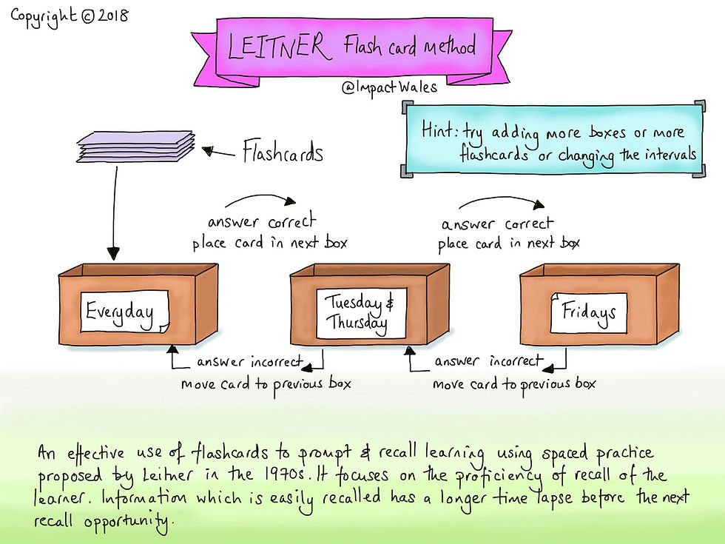

Slide 13
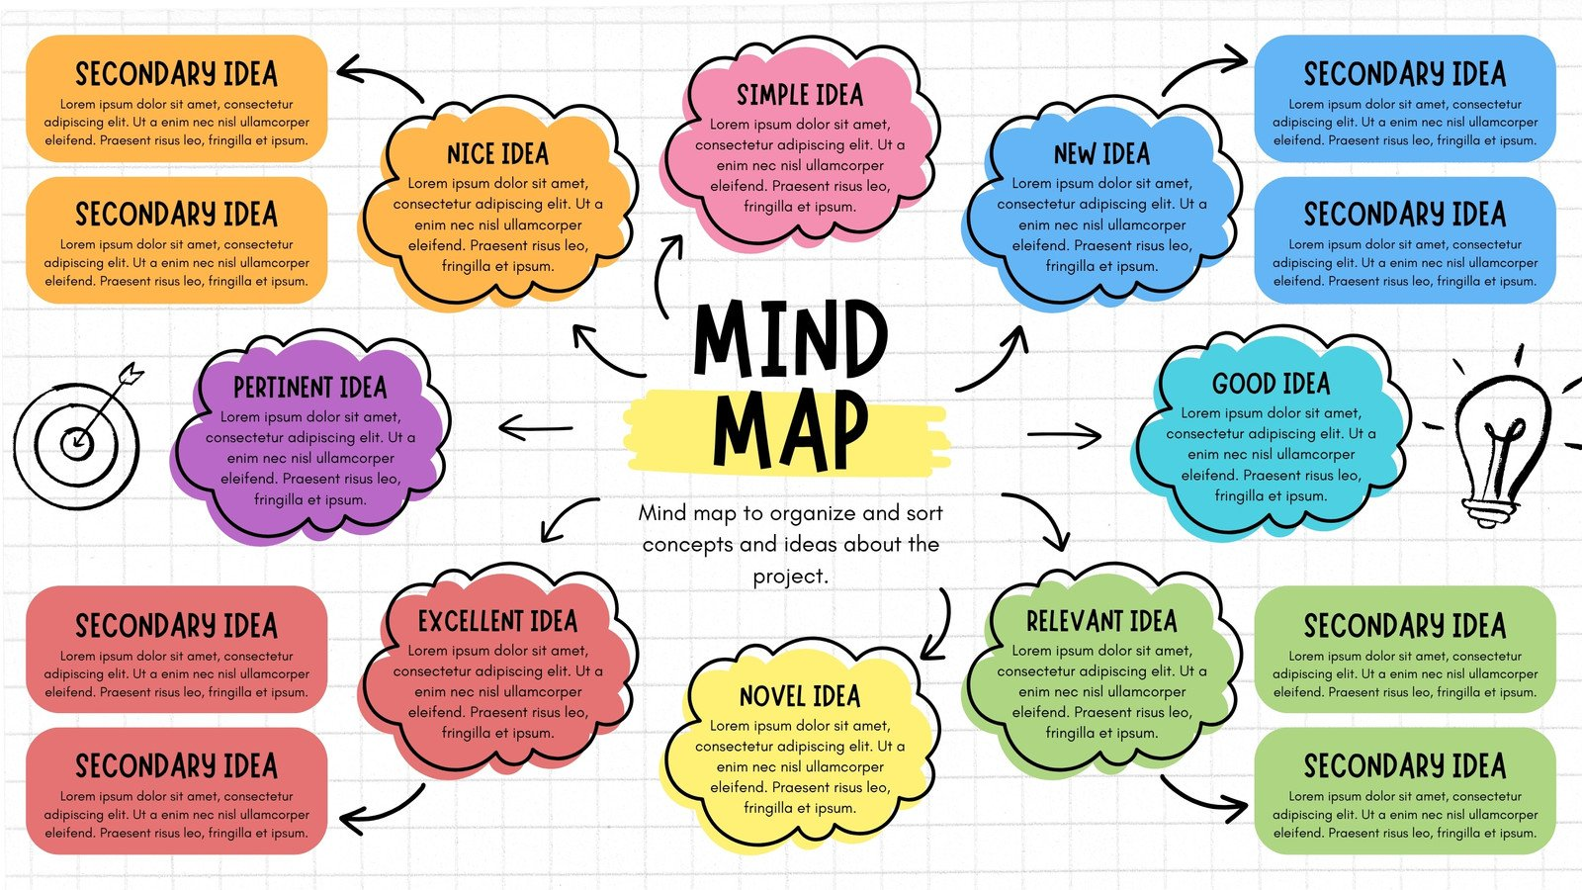

Slide 14
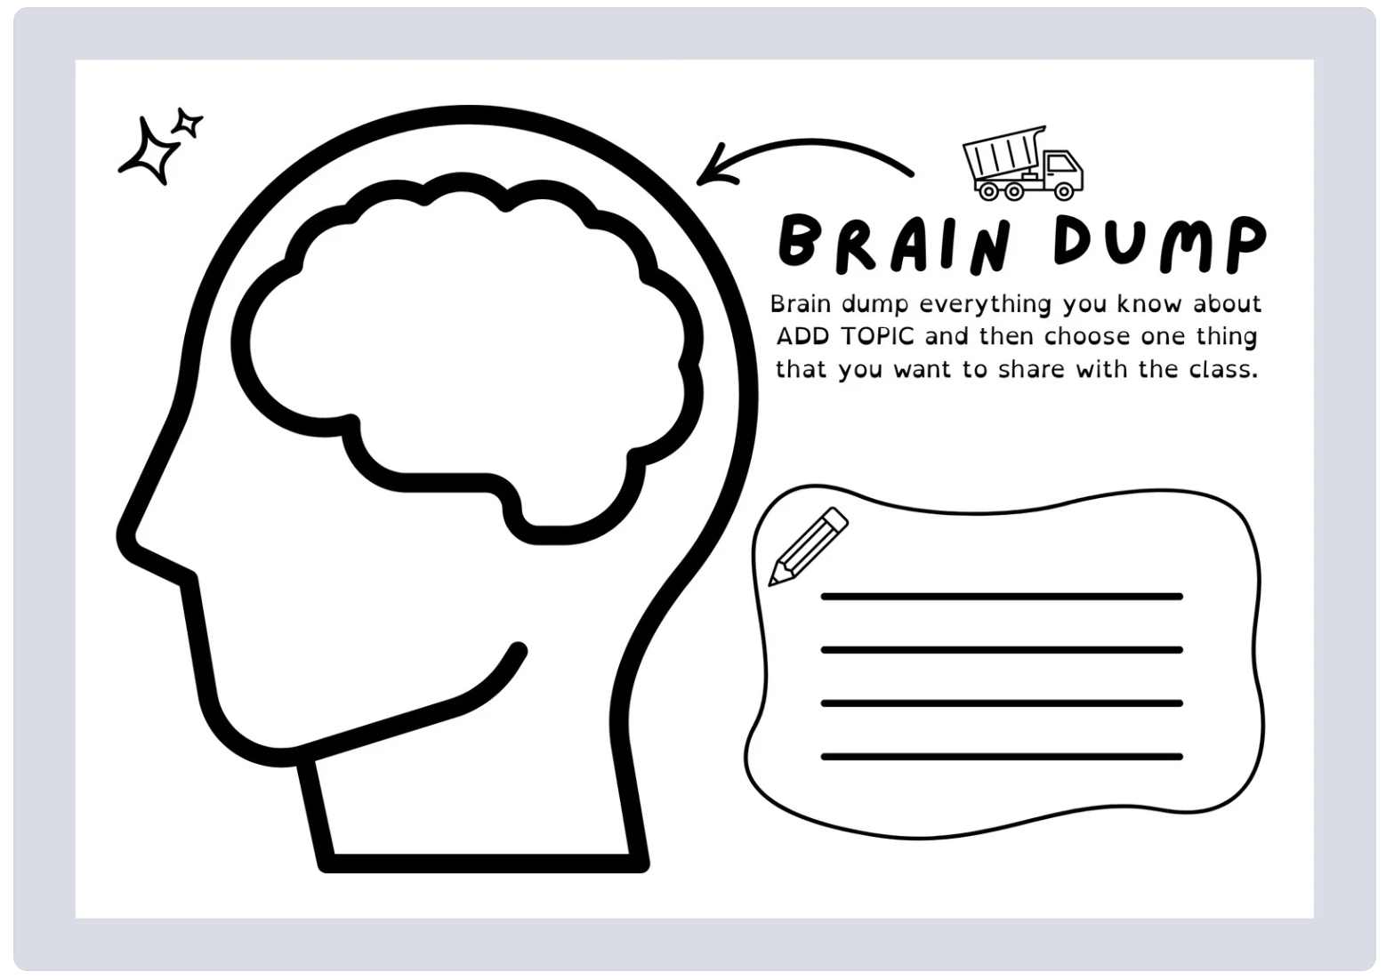

Slide 15
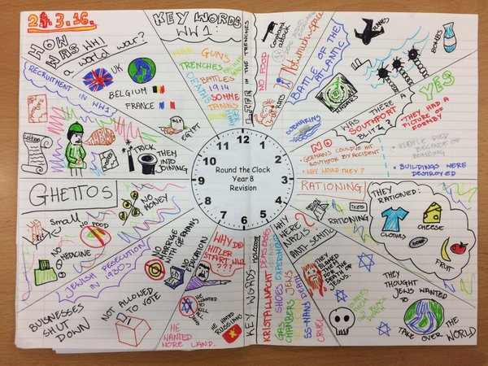

Slide 16
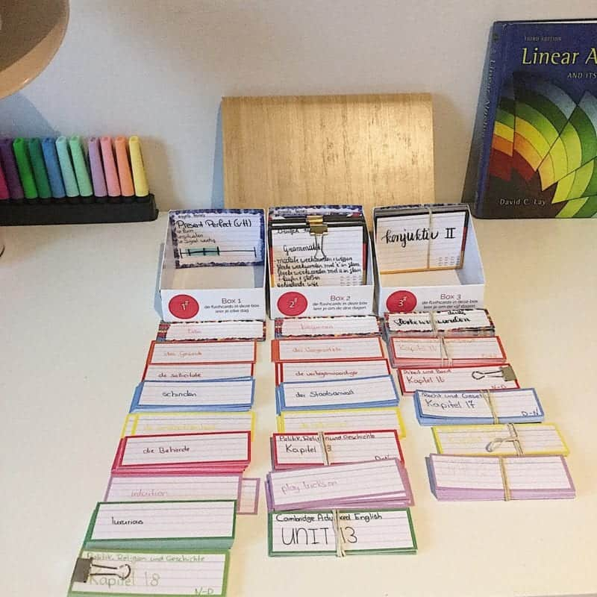
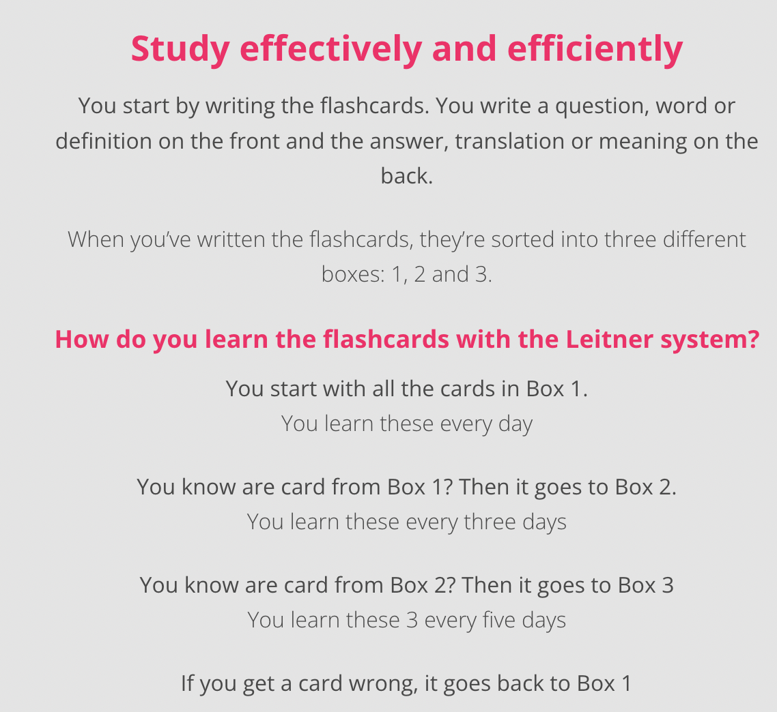
Leitner system for flashcards

Slide 17


Leitner system for flashcards
Notes:
https://www.youtube.com/watch?v=oH-_3NBquSs&list=RDCMUCRG5kdFa2kYVccmtTGob-ZQ&index=1

Slide 18
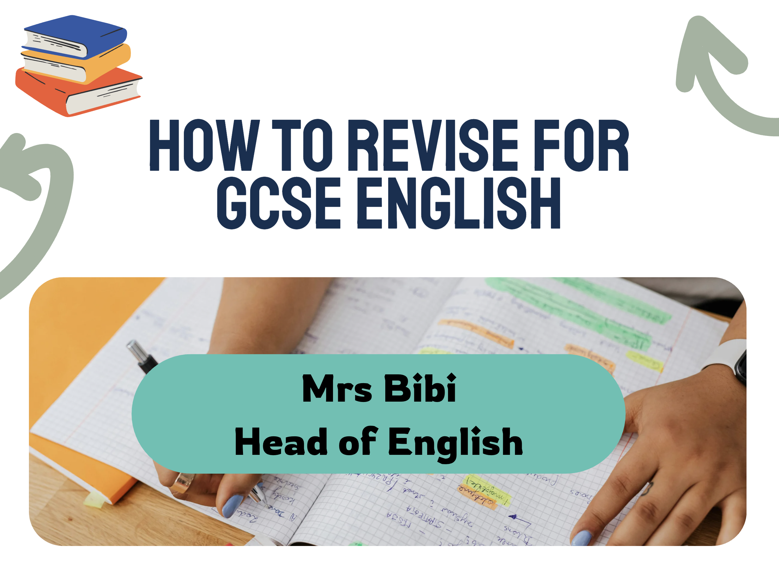

Slide 19
Helping Your Child Revise for AQA English
Objective: Equip you with tools and understanding to help your child achieve top band outcomes through confidence discussion, structured reading and thematic analysis.
English success = clarity + practice + talking ideas through.
You can help by asking, not knowing.
Notes:
State objective first.
Reassure parents they can make a difference.

Slide 20
January Mocks: AQA Language and Literature
Language Paper 1: Fiction extract
Q1 - retrieval
Q2 - language
Q3 - structure
Q4 - evaluation
Q5 - One descriptive/narrative writing task
Literature Paper 1: Set texts
Macbeth
A Christmas Carol
Both exams are closed-book and require understanding of characters, themes and quotes
Notes:
Head up.

Slide 21
Confidence Through Conversation
The Three Golden Questions (usable on ANY text)
What’s happening? What stands out to you? Why might that matter? | Used on: Language extracts Literature themes Character arcs Key quotes
This will turn you into a ‘curiosity companion’, helping your child to rehearse analysis aloud which dramatically improves recall and clarity.
A Recipe for Success: Describe – Zoom in – Connect
Describe: “What are you noticing?”
Zoom in: “Which word shows that?”
Connect: “How does this link to a theme or idea?”
Notes:
This is the heart of the talk — parents leave feeling empowered rather than intimidated.

Slide 22
Confidence Through Conversation:
Describe – Zoom in – Connect (A Short Script)
Parent (Describe): What are you noticing about generosity in A Christmas Carol?
Child: It becomes more important as Scrooge changes. People around him are generous even when he isn’t.
Parent: Good. Now let’s zoom in. Which word or moment shows that most clearly?
Child: The Cratchits’ Christmas dinner. Dickens calls it a “feast,” even though it’s tiny. They treat it as something wonderful because they’re generous in spirit.
Parent: Great spot. Now let’s connect. How does that link to a theme or idea in the story?
Child: It shows that generosity isn’t about money. Instead, it’s about warmth and kindness. Dickens is using their attitude to show what Scrooge is missing and why he needs to change.
Parent: Wonderful. And by the end?
Child: Scrooge becomes generous both emotionally and financially. He “glows” after giving money to the charity collectors. That transformation is Dickens’ message: generosity is the path to human connection and redemption.
Parent: That’s a sharp insight; you’ve shown how he changes and why it matters. Well done!
Notes:
Print

Slide 23
Structured Reading (Turning Chaos into Clarity):
A simple, portable method for Language Paper 1
The 4-Minute Read-Through
Skim the opening (who/where?)
Spot the mood shift (language + structure)
Notice one striking detail (imagery, contrast, rhythm)
Read the ending (resolution or tension?)
This helps your child to track change; essential for Q3 and Q4.

Slide 24
Structured Reading for Literature: The Theme Ladder
Make textual jungles manageable with themes and mini-quotes. Ask your child to pick a theme and climb the ladder:
What is the writer showing about this theme?
Which moments show it best?
What quick quotes support these moments?
How do characters reflect or challenge this theme?
You don’t need to know the text; the student teaches you. This boosts recall and confidence simultaneously.

Slide 25
Theme Ladder: A Short Script on ‘Macbeth’
Parent: Okay, today we’re looking at Macbeth. Pick an important theme for me.
Child: Ambition.
Parent: What is the writer showing about this theme?
Child: That unchecked ambition corrupts people and destroys relationships.
Parent: Which moments show this best?
Child: Macbeth hearing the witches’ prophecy, Lady Macbeth urging him to kill Duncan, and Macbeth deciding to murder Banquo.
Parent: What quick quotes support these moments?
Child: “Vaulting ambition,” “unsex me here,” “fruitless crown.”
Parent: And how do characters reflect or challenge this theme?
Child: Macbeth is consumed by ambition, Lady Macbeth fuels it, and Banquo resists it — which highlights Macbeth’s moral collapse.
Parent: That’s excellent. You’ve shown clear understanding without me needing to know any of the details. Keep going like that.
Notes:
Print

Slide 26
High Impact Revision Strategies:
20-Minute Weekly Talk
Once a week, ask your child to explain:
a theme
a character
a key extract
a Language Paper 1 question
Simply reply with:
“Tell me more.”
“Where does the writer show that?”
“What’s the effect?”
This strengthens retrieval and depth without needing knowledge.

Slide 27
High Impact Revision Strategies:
The ‘Quote Constellations’ Method
Instead of memorising endless lines, your child picks 8–10 quotes per text that cover major themes.
You quiz with:
“Which theme does this show?”
“What word in the quote is doing the heavy lifting?”
This forces precision without overwhelm.

Slide 28
High Impact Revision Strategies:
Timed Micro-Practice
Support by timing short bursts:
5 minutes: Language Q1
10 minutes: Language Q2
12 minutes: Language Q3
18 minutes: Language Q4
10 minutes: Literature paragraph planning
Small storms build strong sailors. Short, regular practice beats hour-long marathons.

Slide 29
High Impact Revision Strategies:
Revision with the Three Colours
Yellow: plot moments
Blue: character development
Pink: themes and symbols
This will let your child organise visually and helps you track progress at a glance.

Slide 30
Building Exam Confidence (so they don’t freeze on the day)
Help your child create:
A “pre-exam ritual”:
skim theme cards
recall a quote constellation
practise one Language micro-question
breathe (four-count box breathing)
A “calm sentence” to start any Literature essay:
The writer presents ___ through ___, demonstrating that… .
This serves as a flexible essay-opening. Practise this with your child on any theme - it builds fluency.

Slide 31
Closing Message
You don’t need to be experts.
They just need to be thinking partners, curiosity nudgers, and calm presences.
With the right scaffolds, you can help your child children unlock articulate, thoughtful, top-band responses.

Slide 32
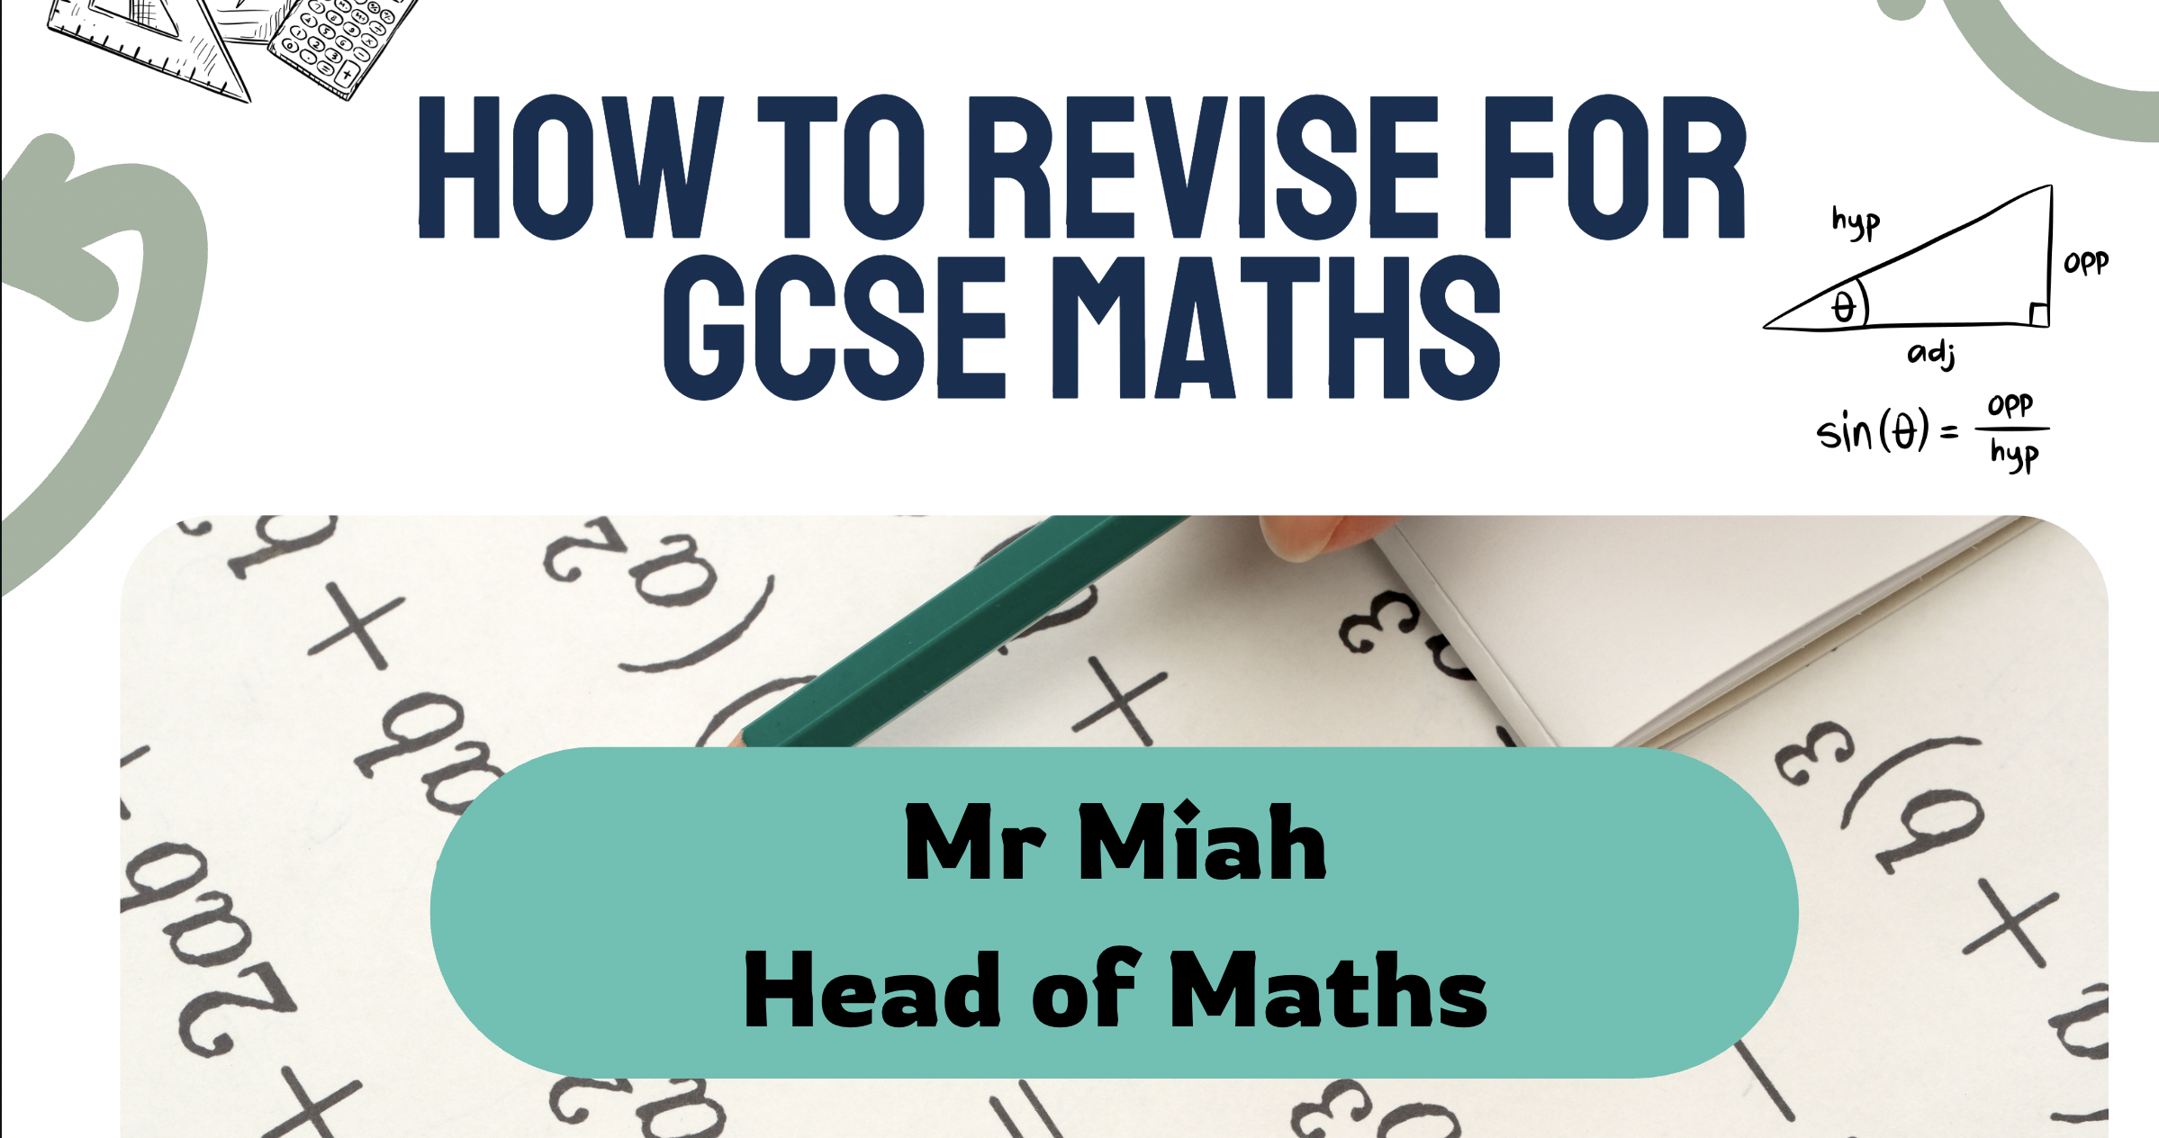

Slide 33

GCSE Maths Overview
An outline of Maths provision, assessment structure and support resources.

Slide 34

Maths Timetable & Setting
Students have Maths 9 times per fortnight.
They are placed in Sets 1–7 based on ability and target grade.
Groupings are reviewed regularly to ensure appropriate support and challenge.
Set 1-3 do higher

Slide 35
Assessment Structure
• Students will complete 3 Maths papers: Paper 1, Paper 2, and Paper 3.
• Mock exams occur 3 times during the year.

Slide 36

• Sparx Maths is our online homework and revision platform.
• Homework is tailored to each student's ability.
• Parents can support by:
- Ensuring students complete their Sparx homework weekly.
- Checking the parent email summary for progress.
- Encouraging good study habits and routine.
• Website: www.sparxmaths.uk

Slide 37
Using Maths Genie
Maths Genie is a fantastic free resource for both students and parents. It includes:
- Topic-based revision notes and exam questions
- Full GCSE papers with mark schemes
- Video tutorials for a wide range of topics
- Ideal for targeted revision and practice
Website: www.mathsgenie.co.uk
Encourage your child to use Maths Genie regularly to consolidate learning and prepare for assessments.

Slide 38
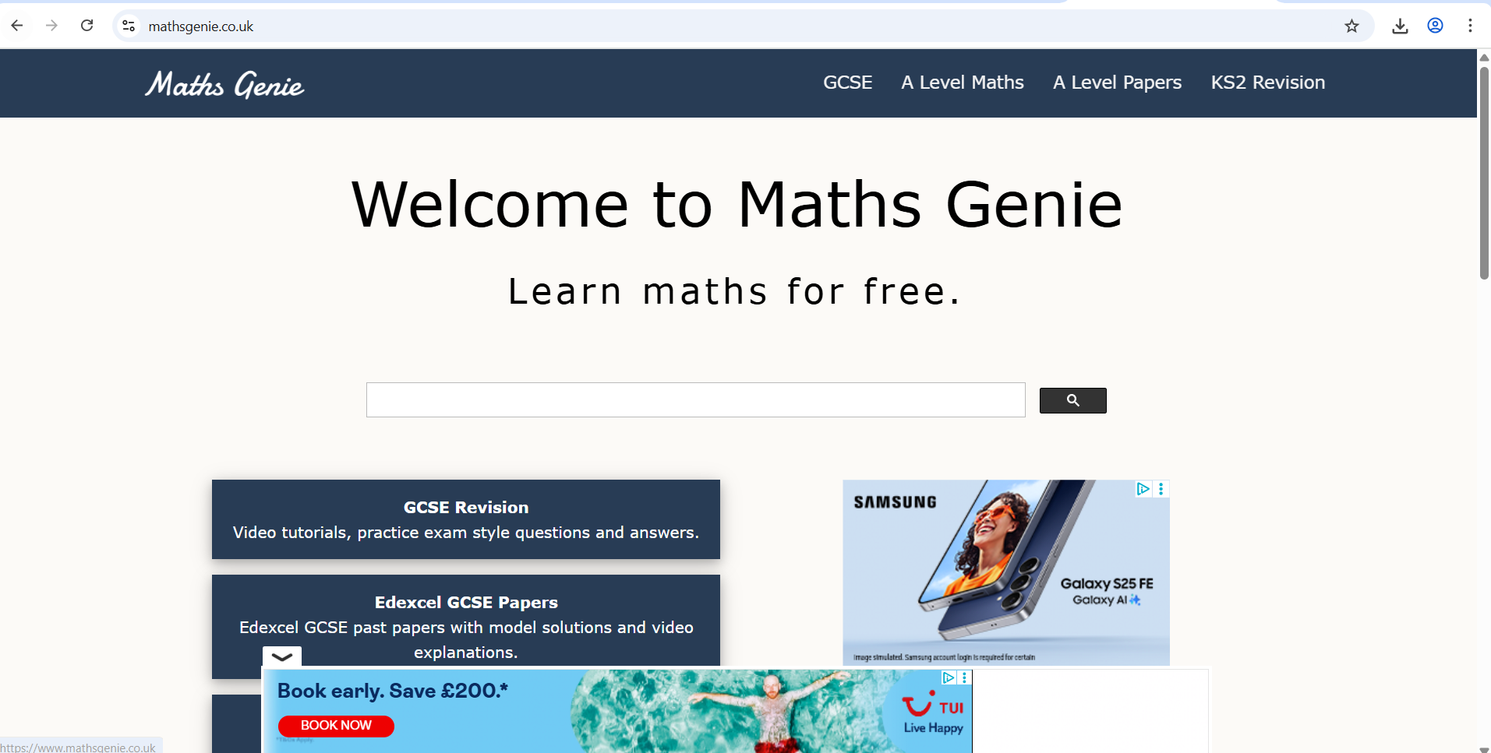

Slide 39
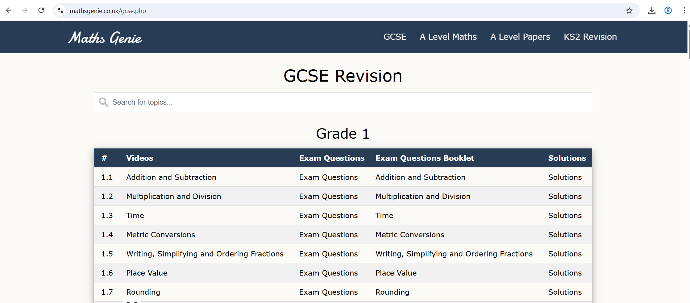

Slide 40
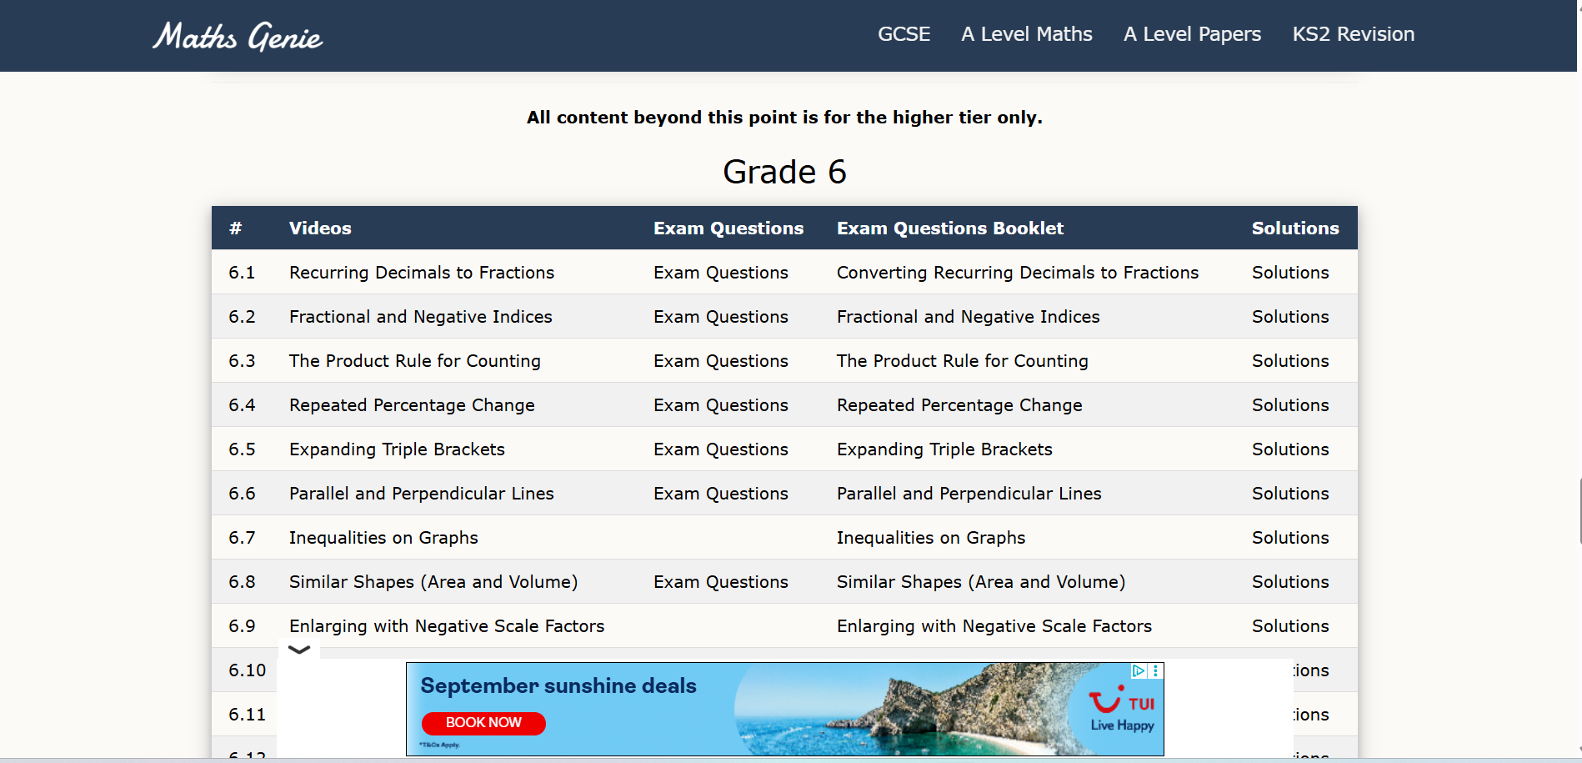

Slide 41
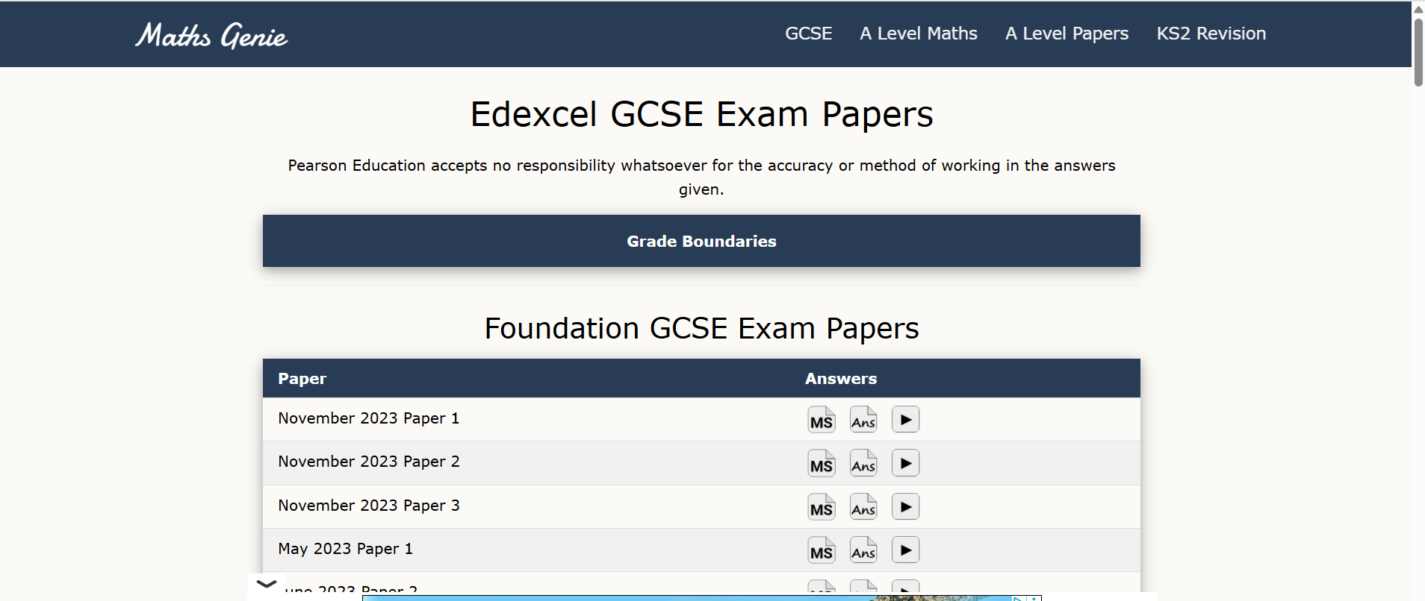

Slide 42
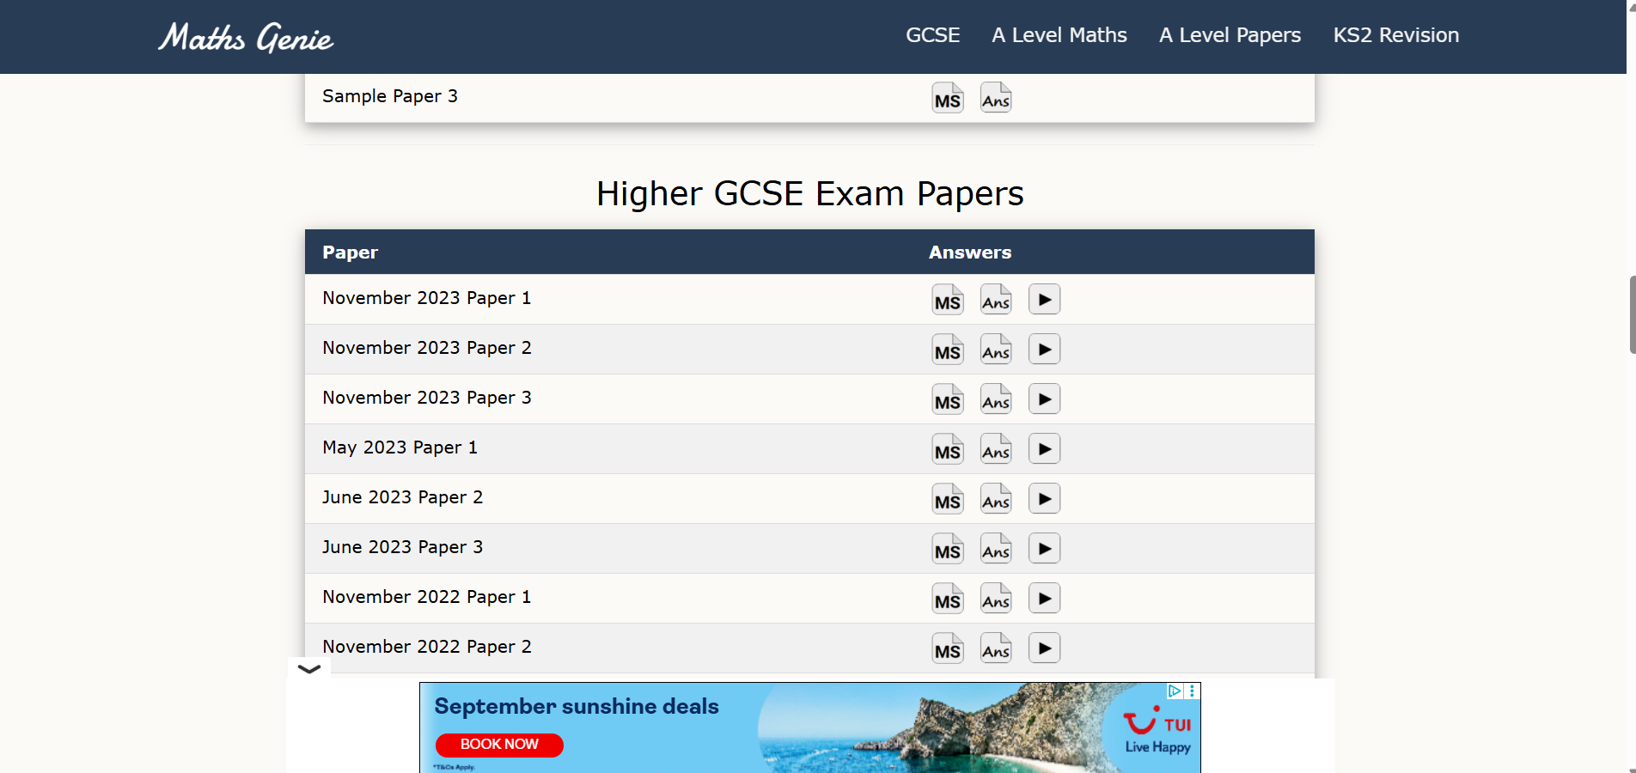

Slide 43
How Parents Can Support at Home
• Encourage consistent Sparx Maths homework completion – 100% is the goal each week.
• Check their weekly Sparx score and praise improvements.
• Ensure students have a quiet space and time set aside for revision.
• Discuss what they learned that week – even if you're not a maths expert!
• Help them stick to a revision schedule, especially before assessments.
• Use Sparx videos and Mathsgenie videos to revisit tricky topics.
• Celebrate small successes and progress to keep motivation high.

Slide 44
• Encourage your child to speak to their teacher if they're stuck.
• Revision guides and maths genie workbooks are available – ask the Maths team for recommendations.
• Use the TFA website for term dates, policies, and further resources.
• Contact the Maths Department via the school office for queries or extra support.
Further Support & Contact

Slide 45


