Slide 1

Mr Williamson's
Geography – Edexcel specification interpretation

Slide 2

Using the textbooks
Pearson Active Learn login: https://www.pearsonactivelearn.com/app/Home
Book 1 = Year 12 content (Coasts, Tectonics, Regeneration and Globalisation)
Book 2 = Year 13 content (Water, Carbon, Superpowers and Health and Human Rights)

Slide 3
How to use this information
It should guide your revision
You must make notes and understand the content in your notes before attempting questions
In the booklet there are:
Sections with indication of what the case studies are where relevant – but you must not just revise case studies. You must be able to apply them to the question with an argument
Guidance on what to revise and how to revise for sections of the spec
Textbook pages for revision of relevant sections
Approx. 143 questions for physical content to practice
Approx. 138 questions for human content to practice
Not expected that you attempt all the questions- read them – think about how you would answer them. Attempt some – bring to your geography teacher
Just do arguments for 12 or 20 mark questions?
This is Mr Williamson’s interpretation of the specification. Note that not all questions provided in this booklet is my ‘best educated guess’ of what could come up.

Slide 4
Paper 1
Tectonics (16 marks)
Coasts (40 marks)
Physical Systems and Sustainability: Water and Carbon (49 marks)
Do not answer questions on ‘Glaciation’ in this paper

Slide 5
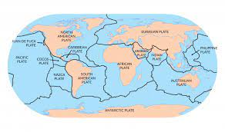
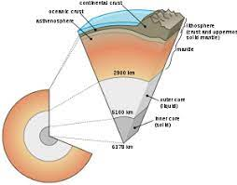
Tectonics – 16 marks (4 mark + 12 mark)

Slide 6
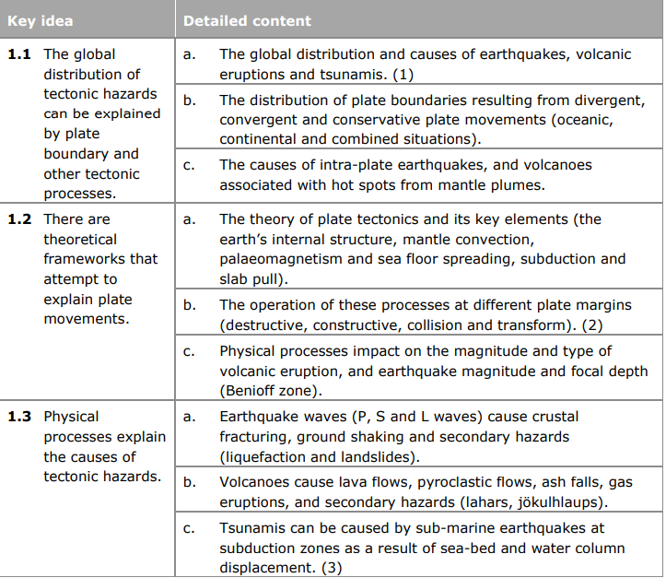
Lessons 1, 2, 3, 4, 5
Lessons 6 , 7 , 8 – teach you the understanding of secondary hazards (case studies not relevant to spec until later on)
For 1.1 and 1.2 no explicit case studies here, but a lot of underlying 'theory' which can be used as examples. Definitely know the names of named plate margins. Whilst this page is most likely used for shorter answer questions, the theories which underpin them can be applied to 12 mark questions. E.g. Worth revising 1.2c. The 'factors which impact on the magnitude' of earthquakes and volcanoes can be used as a 12 marker. Whilst there are no explicit case studies for 1.2c you can always use examples taught later on in this unit to support any answer.
For this part of the spec. The word 'explain' is present in 1.2 and 1.3 key ideas. So more likely to be a shorter answer question than longer answer question … but see below for some ways in which the content can be used for a 12 mark question.
Questions:
Explain why tectonic hazards occur near plate margins (4)
Explain why some tectonic hazards do not occur near plate margins (4)
Explain the physical factors which impact the magnitude of earthquakes (4)
Explain the physical factors which impact the magnitude of volcanoes (4)
Explain the secondary hazards of volcanoes (4)
Explain the secondary hazards of earthquakes (4)
Explain the causes of tsunamis (4)
Explain the theory of tectonic plates (4)
Typically the exam board like to give a skills question for the shorter part of the tectonics questions i.e. it is unlikely that you will get a whole four mark question. Most often they give you a skills based question for 2 marks and a further 2 marks for discussing the trend identified in the skill. The 4 mark questions above give you some support with discussing trends should you get a 'skill' on the question content.
Questions:
Assess the physical processes which impact the magnitude of volcanic eruptions (12)
Assess the physical processes which impact the magnitude of earthquakes (12)
The wording of the two questions above is interesting. The question and spec uses the word 'impact' but the questions aren't about impacts but the factors which influence the magnitude. Be careful.
Assess the severity of impacts caused by secondary hazards of earthquakes (12)
Assess the severity of impacts caused by secondary hazards of volcanoes (12)
Assess the physical processes which cause tectonic hazards (12)
Assess the physical processes which cause tsunamis (12)
Assess the physical processes which cause earthquakes (12)
Assess the physical processes which cause volcanoes (12)
This could also be a skills based question on 1.1 where you are given a map of global distribution of earthquakes and volcanoes. I suspect you could get asked basic skills on these questions e.g. mean, mode, median of distribution or spearman's rank/standard deviation on disbribution
Textbook pages 20 - 37

Slide 7
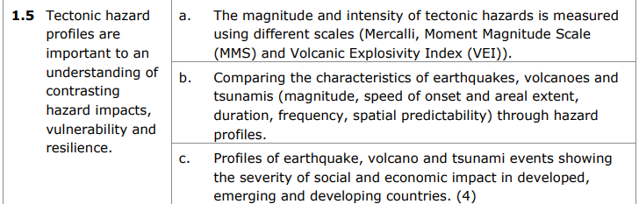
Lesson 11
Revise case studies here (lessons 6-8)
Volcanoes: Eyjafjallajokull 2010
Earthquakes: Kashmir 2005, Haiti 2010 and Christchurch 2011
Tsunami: Tohuku 2011 and Indian Ocean 2004
Revise Tectonic hazard profiles. They link well to previous specification section 1.3 as they can be used to show the factors which determine the severity of impacts of earthquakes, volcanoes and tsunamis. It is worth noting the hazard profiles for your case studies for this unit. Hazard profiles are useful for comparing impacts between case studies of the same hazards. Revise the limitations of hazard profiles also.
Really revise 1.5b - know the specific aspects of hazard profiles and what they mean
I've put this section on its own. Whilst you can get a question explicitly on hazard profiles. They demonstrate much more than that. They can be used to exemplify why impacts are worse than some countries compared to others (vulnerability), they can also be used to show the factors which contribute to the impacts (spec 1.3).
Questions:
Assess the view that the higher the magnitude the more severe the impacts of tectonic hazards (12)
Assess how hazard profiles can be used to develop an understanding of the contrasting impacts of tectonic hazards (12)
Assess how hazards profiles can be used to show an understanding of vulnerability and resilience to tectonic hazards (12)
For the questions above you could be directed to specific hazards e.g. Assess the view that the higher the magnitude the more severe the impacts of earthquakes (12). If you have time try specific hazard based questions for the above.
You could be shown hazard profiles and be asked to 'explain' or 'assess' what they show...
1.5a is seemingly not related to 1.5b and c itself. Revise the scales used to measure magnitude. They could be used in a skills based question e.g. they show you a table of a series of earthquakes which are shown to be measured in the MMS and you have to do a 'skill' based on the numbers. E.g. mean, mode, median, standard deviation … .
Page 44-45 of your textbook

Slide 8
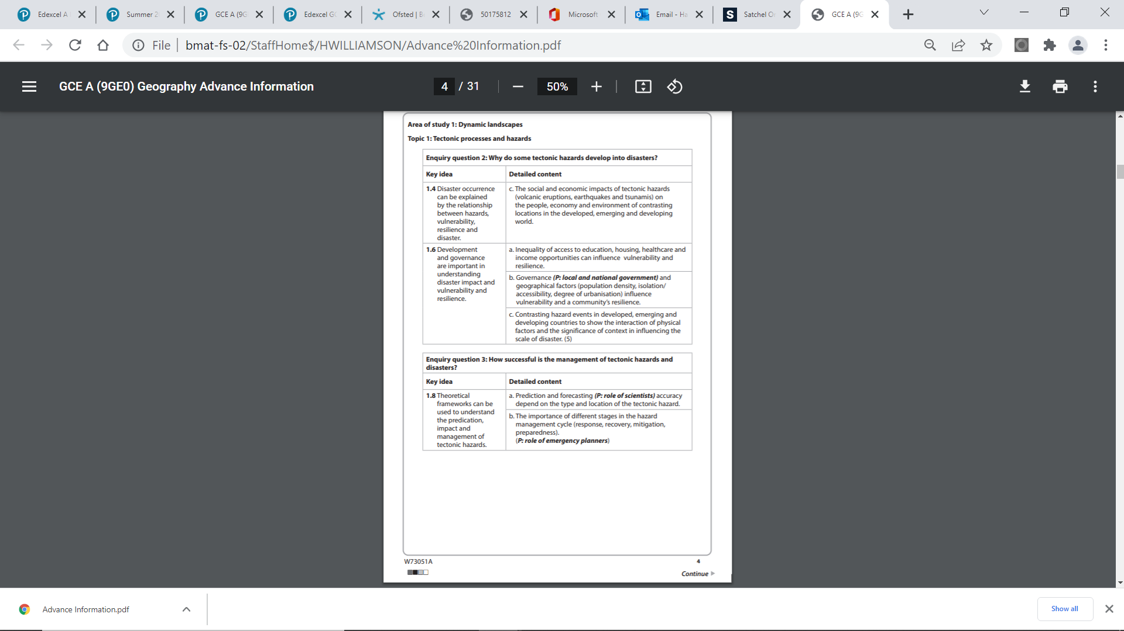
Lesson 9 and 10 , 12 and 13
Revise case studies here (lessons 6-8)
Volcanoes: Eyjafjallajokull 2010
Earthquakes: Kashmir 2005, Haiti 2010 and Christchurch 2011
Tsunami: Tohuku 2011 and Indian Ocean 2004
Questions:
Explain why the impacts of tectonic hazards vary according to the level of development of a country (4)
Explain why the impacts of volcanic eruptions/earthquakes/tsunami vary according to the level of development of a country (4)
Explain the impacts of [insert named hazard here] on the people, economy and environment
Define risk (1)
Define vulnerability (1)
Explain why some countries are more vulnerable than others to the effects of tectonic hazards (4)
Generally 1.4, 1.5 and 1.6 seem to be combined. Both require an understanding of vulnerability. Make sure you know this concept. Know the PAR model as a way of demonstrating how vulnerability to tectonic hazards occurs. So this could be a 12 mark question also
Questions:
Assess the role of governance in creating vulnerability to tectonic hazards (12 marks)
Assess the role of development in creating vulnerability to tectonic hazards (12 marks)
Assess why, even within a country, some people are more vulnerable to hazards than others (12)
Assess the role of development and governance in creating vulnerability to tectonic hazards (12 marks)
Assess the factors which create vulnerability to tectonic hazards (12 marks) – refer to ideas mentioned in 1.6 here
Assess the factors which create resilience to tectonic hazards (12 marks)
Note that 1.4 and 1.6 require a variety of hazards i.e. volcanic eruptions, earthquakes and tsunamis – so know your case studies for these listed above.
This could also be a skills based question where you are given varying impacts of a named hazard in different location and you may have to work out mean/mode/median, correlation, graph completion, t-test and chi squared. Revise these skills
Textbook pages 30-40 and pg 42-44 and pg46-50
Your textbook has some really useful skills based content on these sections pg. 48-50 (practice these skills questions!)

Slide 9
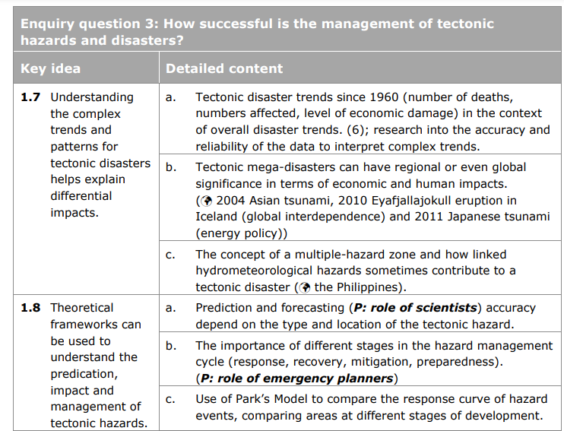
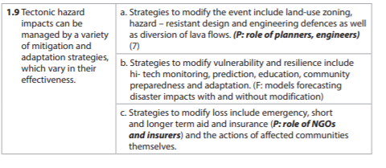
1.7 = lesson 14 and 15 – Case study Philippines
1.8 = lesson 16 and 18 – case studies 2004 Tsunami, 2010 Eyafjafallajokull eruption and 2011 Tohoku Tsunami
1.9 = lesson 19 and 20
Questions
Assess the role of planners in modifying the impacts of tectonic hazards (12)
Assess the role of mitigation and adaptation techniques in modifying the impacts of tectonic hazards (12)
Explain why the impacts of managing tectonic hazards can vary in their effectiveness (4)
Assess why the impacts of managing tectonic hazards can vary in their effectiveness (12)
Assess the role of prediction and forecasting in managing the impacts of tectonic hazards (12)
Explain why insurance companies may be interested in encouraging the accurate prediction of, and effective preparation for, a tectonic hazard (4)
Assess how hydrometeorological hazards can contribute to tectonic disasters (12)
Assess the local and global impacts of tectonic mega-disasters (12)
Assess the economic and human impacts of tectonic mega disasters (12)
Assess the view that we are living in a more hazardous world (12)
Assess the usefulness of theoretical frameworks in understanding the prediction, impact and management of tectonic hazards (12)
1.7 lends itself more to shorter answer questions where statistical analysis is relevant (particularly 1.7a and b). Page 52 and 48 show examples of skills based questions on this content. However 1.7c and how hydrometeorological hazards contribute to tectonic disasters can be quite tricky questions to answer so do go over this content.
1.7 has been rarely examined since the spec has been published …....
Textbook pages 51-62
The pages on the textbook are really useful for this!

Slide 10
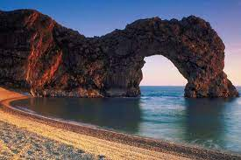
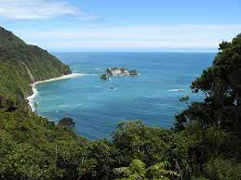
Coasts – 40 marks (6, 6, 8, 20)

Slide 11
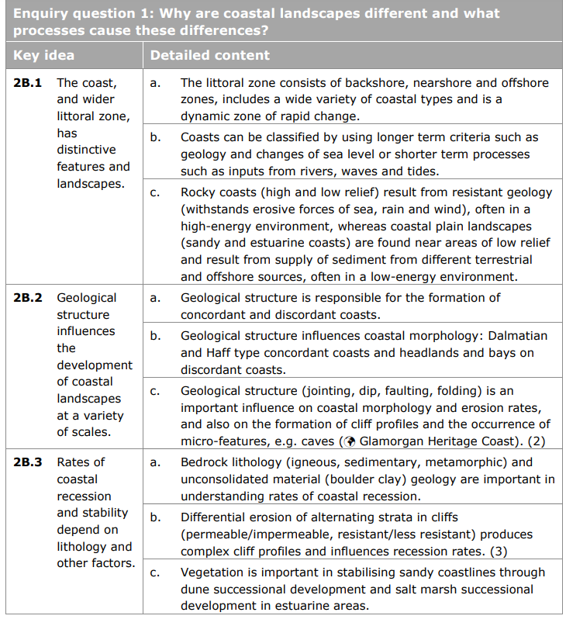
Lessons 1 - 8
This section screams ‘resource’ to me. In short you could be given an image (like the ones on the following pages) and get asked exam questions such as:
Explain the features of the backshore and foreshore of the littoral zone shown in Figure 1 (6)
Geology is a very important concept to understanding – particularly in terms of how it impacts the coastline (2b.2)
Explain how geological structure influences the development of coastlines (6)
Explain how geological structure has influenced the development of the coastline shown in Figure 2 (6)
Explain how geological structure has influenced the development of the coastline shown in Figure 3 (6)
Remember – if the question is directing you to explain how 'geological structure' has influenced a coastline – do refer to other factors you can see in the image. But also do refer to geological structure. Think – concordant or discordant coastline, what factors of erosion are prevalent, what role does vegetation play, are there differing rates of recession and why.....
Evaluate the role of geological structure on influencing the morphology of coastlines (20)
Interestingly 2b.3c sand dunes and salt marshes have been examined a lot at AS but not A2. Do revise them though, a common mistake that students make is to not use the names of specific vegetation within their answers.
Explain how vegetation can bring stability to sandy coastlines (6) (refer to both sand dunes and salt marshes here)
Pages 118-125

Slide 12
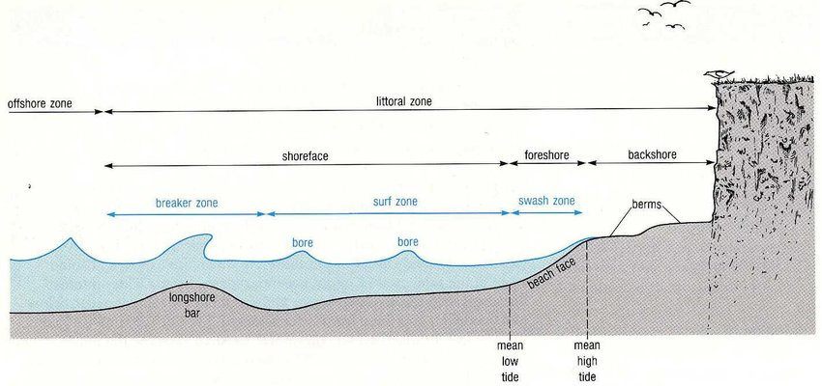
Figure 1

Slide 13
Figure 2

Slide 14
Figure 3

Slide 15
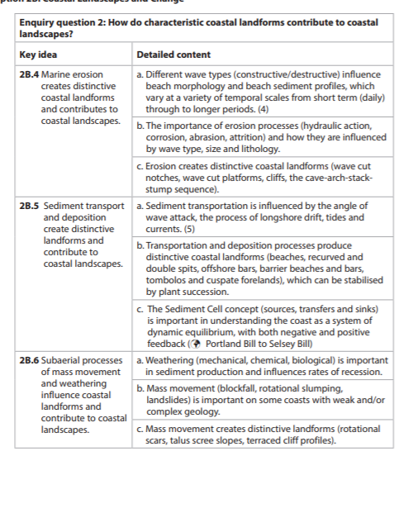
Lessons 1, 5, 9, 10 and 11 are all relevant here
This section screams ‘resource’ to me. In short you could be given an image (like the ones on the following pages) and get asked exam questions such as:
Explain the role of erosional processes in creating the distinct landform shown in Figure 4 (6)
Explain the role of subaerial processes in creating the distinct landform shown in Figure 4 (6)
Explain the role of deposition and transport in creating the distinct landform shown in Figure 5 (6)
Big tip: You should not just refer to the processes mentioned in the question in your answer. Study the image carefully in the exam if this is a resource question. What other processes are evident? Refer to them in your answer, and make sure you use evidence from the resource in your answer e.g. “as seen in the foreground of the image in Figure 1 there is a wave cut platform, this is created…..”
There is also the sediment cell concept in 2B.5c
Question: Explain the sediment cell concept (6)
You would be required to use a case study here. Lesson 1 teaches you about The Wash which is sediment cell 3. You would need to be able to explain here how the coast can be treated as a system of inputs, processes and outputs.
Pages 126-139
This section could also see skills tests. Page 136, 132-133 have some useful activities on this.

Slide 16
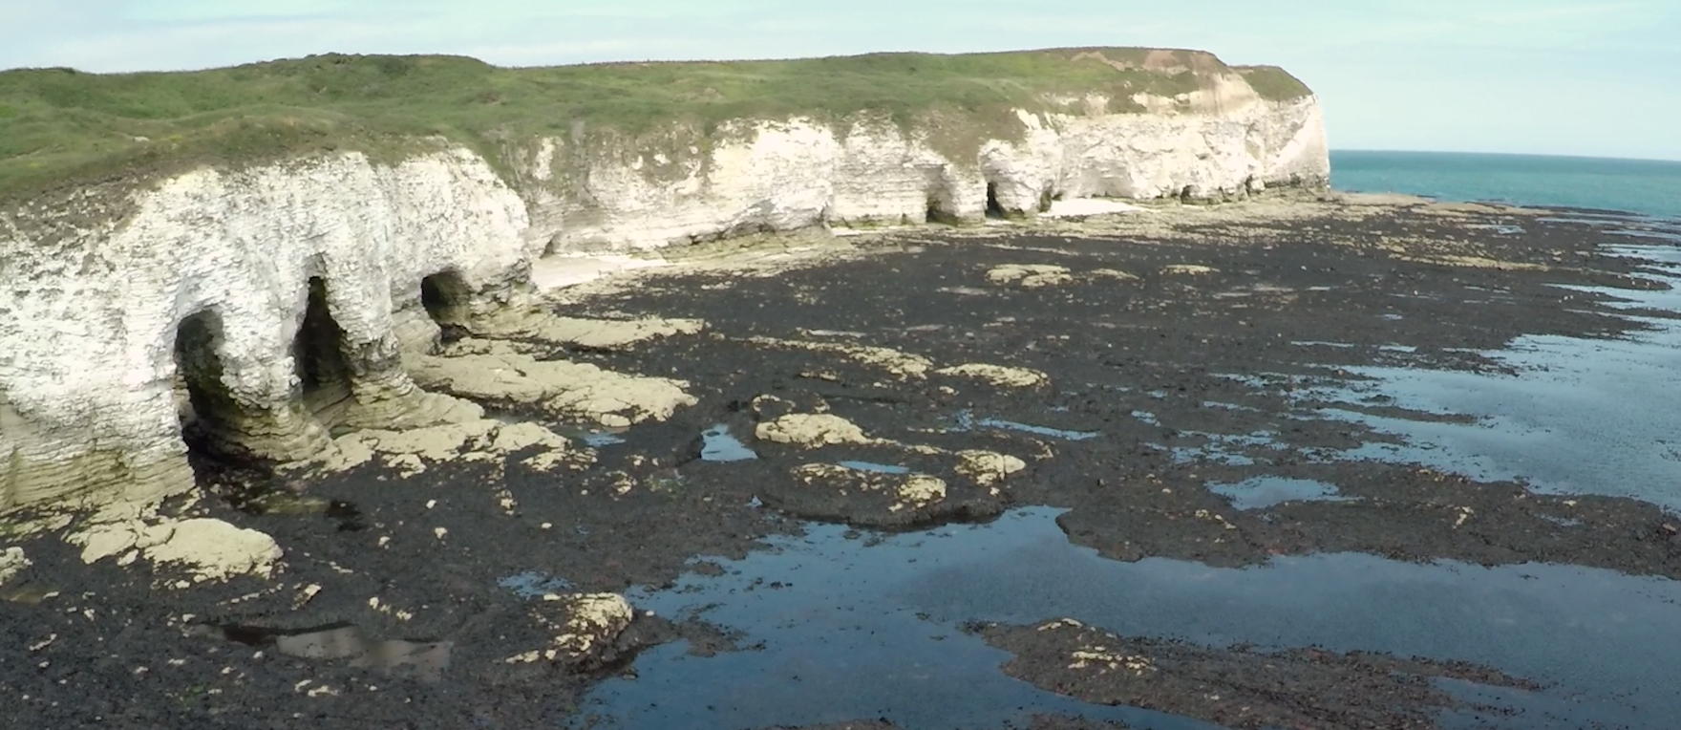
Figure 4

Slide 17
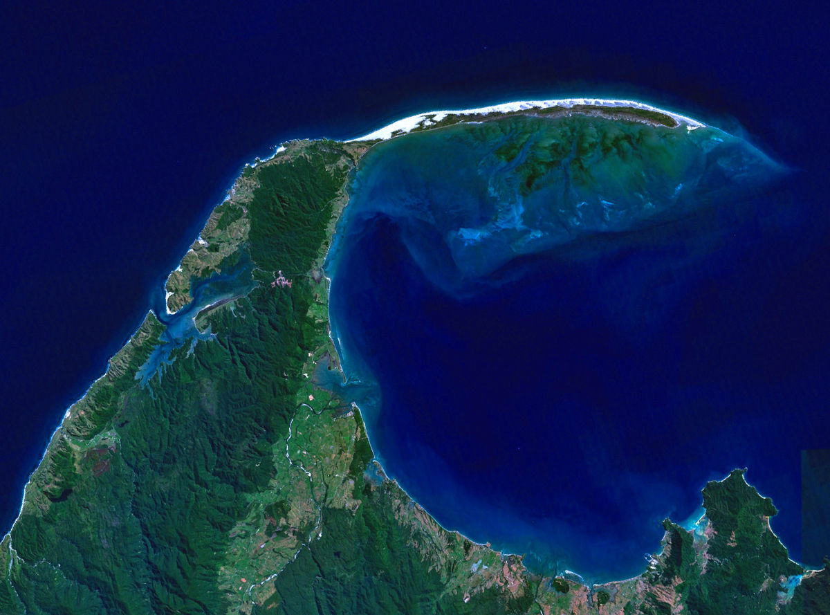
Figure 5

Slide 18
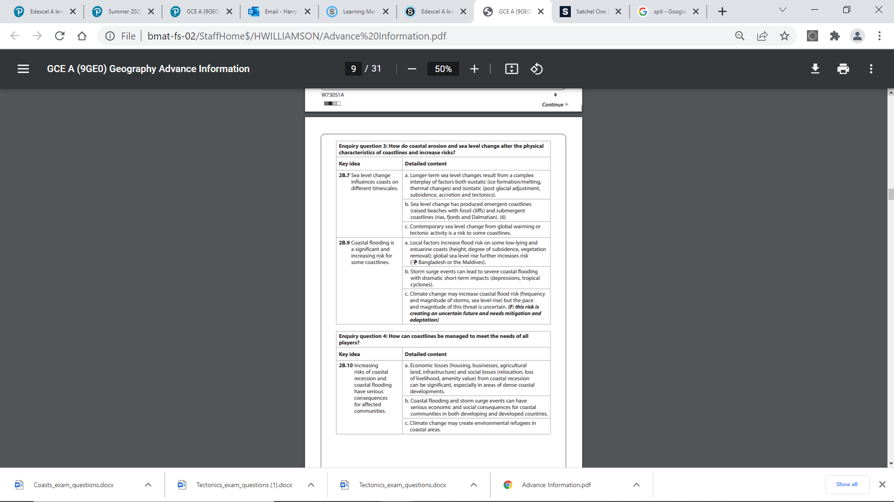
Lessons 12, 13, 15, 16, 17 are all relevant lessons here
This section is more likely to be an ‘explain’ or ‘evaluate’ question. It seems to deal with the key ideas of sea level change, coastal flooding and risk. Make sure you know case studies here and the factors which increase risk along coastlines.
Explain the factors which increase risk of coastal flooding (8)
Explain the factors which increase sea level change (8)
Explain the landforms which can be created by eustatic and isostatic sea level change (8)
Explain how sea level change is creating increasing risk for some coastlines (8)
Explain the human and physical factors which increase the risk of flooding for some coastlines (8)
Explain how coastlines can be managed to minimise risk (8)
Explain how the increased risk of flooding and sea level rise can create environmental refugees in some locations (8)
Explain the consequences of the increasing risk of sea level rise and coastal recession (8)
Evaluate the factors which are increasing the risk of flooding for some coastlines (20)
Evaluate the view that climate change is increasing the risk for some coastlines (20)
Evaluate the role of climate change in increasing risk for some coastlines (20)
Evaluate the view that the increasing risk of sea level rise and coastal recession has more serious consequences for developing nations than developed (20)
For all 20 mark questions noted above, even if the question is only directing you to ‘one’ factor e.g. climate change – you would be expected to bring in understanding from all aspects listed in the advance information here.
Have a definition of ‘risk’ ready to go for any introduction to the above questions.
Page 140-155 of your textbook

Slide 19
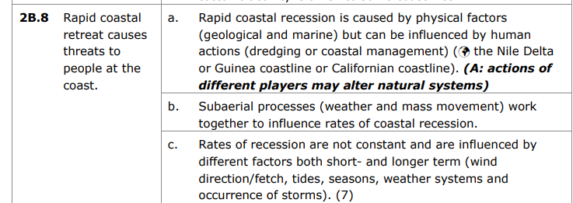
Lesson 14 – case study Nile Delta
This section is more likely to be an ‘explain’ or ‘evaluate’ question. It seems to deal with the key ideas of sea level change, coastal flooding and risk. Make sure you know case studies here and the factors which increase risk along coastlines.
Explain how rates of recession at the coastline can be influenced by people (8)
Evaluate the causes of coastal recession (20)
Note you can refer to more than human causes with both questions above, and the content of these questions also relates to the previous slide 15 content. Remember that humans exacerbate the problems of coastal recession at the coastline.....BUT they can also solve the issue (with varying levels of success) through coastal management....
Page 144-145

Slide 20
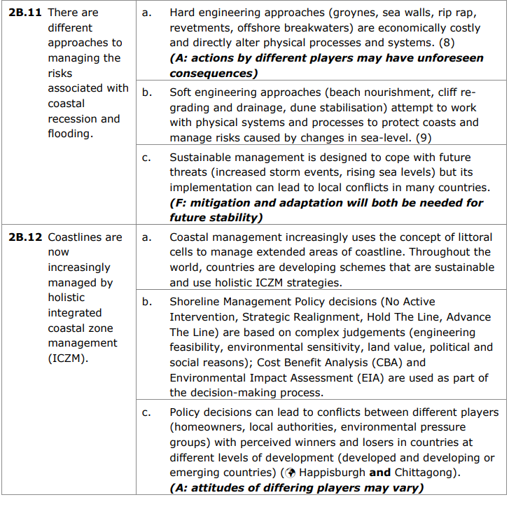
Lessons 18-21
This section is coastal management. Firstly know the difference between hard/soft management vs sustainable management....they are very different!
Hard/Soft: Walton on the Naze, Happisburgh
Shoreline management plans (Holistic): Holderness
ICZM (Holistic): Mediterranean coastline
Sustainable: Maldives Mangroves For Future
Could be 8 mark content or 20 mark content
Explain the different approaches to managing risk of coastal recession at coastlines (8)
Explain how hard and soft engineering strategies can be used to mange coastlines (8)
Explain how sustainable management can be used to manage coastal recession at coastlines (8)
Explain how ICZM strategies can be used to manage the risk of coastal recession at coastlines (8)
Explain how shoreline management plans can be used to manage the risk of coastal recession at coastlines (8)
Explain how policy decisions used to manage coastlines can create conflict (8)
Evaluate the view that coastlines should be managed sustainably (20)
Evaluate the different approaches to managing coastlines (20)
Evaluate the consequences of holistic coastal management in creating conflict (20)
Evaluate the success of policies which are designed to manage the coastline holistically (20)
With the evaluate questions – you can/should refer to both 2b.12 and 2b.13 case studies/examples in your answer where relevant
Note the questions can explicitly direct you to managing flooding and/or recession – make sure you select the right case study for the right management strategy. E.g. Holderness is management for recession whereas Mangroves For Future is for flooding.
Pages 152-163

Slide 21

Physical Systems and Sustainability – Water and Carbon – 49 marks (3, 6, 8, 12, 20)

Slide 22
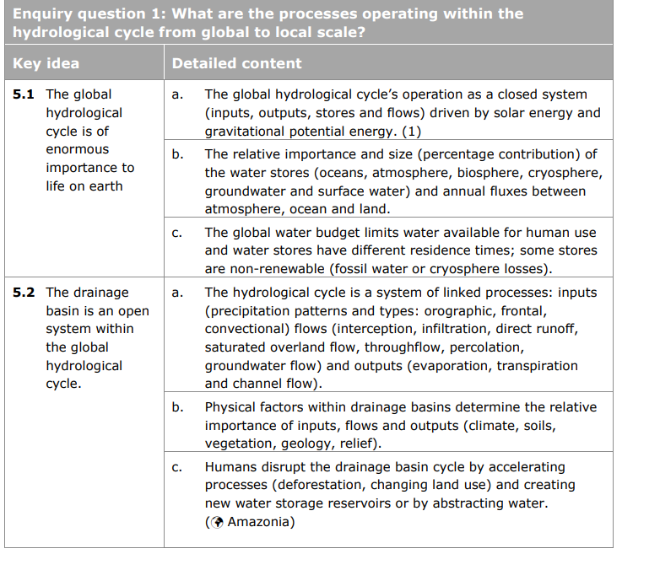
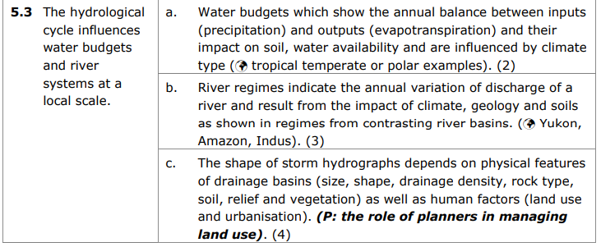
Lessons 1-6
Case study: River regimes: Yukon, Amazon and Mississippi
The 3 mark question of this paper is sometimes resource based and based on your understanding of a 'cycle'
e.g. Study Figure 1, explain how the global hydrological cycle is closed (3)
Study Figure 1, explain how the hydrological cycle is a mix of inputs, flows and outputs (3)
Explain how the drainage basin is an open system within the global hydrological cycle (6)
5.3 is often a source (excuse the pun) of difficulty for students. But they are quite simple. You just need to know why different river discharge varies (the spec identifies the different factors). I would suggest for each of the three case studies you know how and why they vary between one another.
In regards to storm hydrographs page. 36-37 of the textbook explains this content simply and clearly
Explain how river regimes vary (8)
Study Figure 2, explain the reasons for the difference in shapes between storm hydrographs (6)
Page 24 - 39

Slide 23
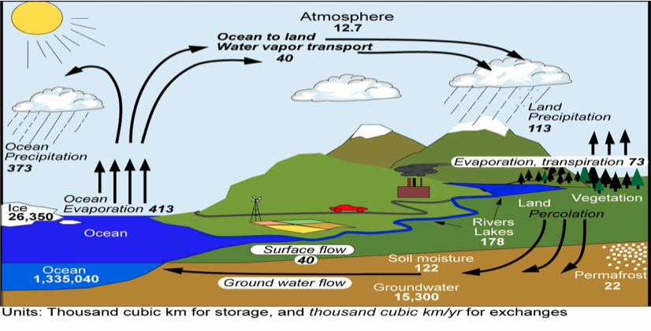
Figure 1

Slide 24
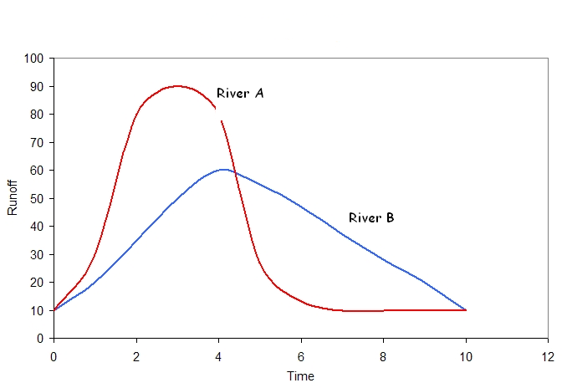
Figure 2

Slide 25
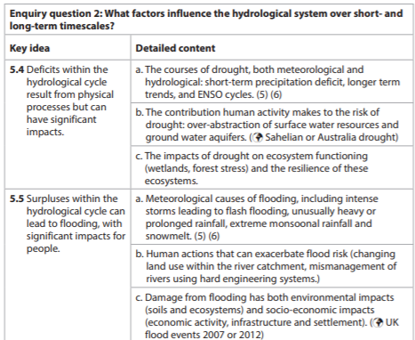
Lessons 7, 8, 9 and 10
Remember surpluses = flooding and deficits = drought. Definitely revise the causes and impacts of both. ENSO is a key area of understanding here.
Explain the impacts that surpluses and deficits may have on people (8)
Explain the causes of drought (6)
Explain the causes of flooding (6)
Explain the human and physical factors which create surpluses in the water cycle (8)
Explain the human and physical factors which create deficits in the water cycle (8)
Explain the meteorological causes of flooding (8)
Explain the meteorological causes of drought (8)
Explain the role of ENSO in creating surpluses and deficits in the water cycle (8)
Assess the human and physical causes of drought (12)
Assess the human and physical causes of flooding (12)
Assess the impacts of drought on people (12)
Assess the impacts of flooding on people (12)
This could be a short 3 mark skills question on a water budget where you may be asked a simple maths question on surpluses and deficits e.g. textbook pg 44 has a simple diagram of ENSO and you could be asked to do activity 1 or 2 on page 44 (do this as good practice). Also attempt the activity on page 48
Page 40-54 of your textbook

Slide 26
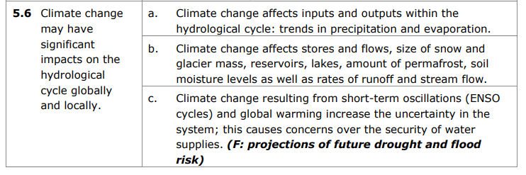
Lesson 11
Explain the impacts of climate change on the water cycle (8)
Explain how climate change will affect the stores and flows within the water cycle (8)
Explain how permafrost will be affected by climate change (6)
Explain how snow and glacier mass will be affected by climate change (6)
Explain how soil moisture level will be affected by climate change (6)
Explain how climate change can cause concerns over the security of water (6)
Anything ‘climate change’ could be a 20 mark question
e.g.
Evaluate how climate change may have both local and global impacts on the hydrological cycle (20)
Evaluate how the impacts of climate change on the water cycle will vary (20)
Make sure you revise the impacts with reference to locations.
Page 55-57 of your textbook covers this.
Remember the impacts of climate change vary both spatially and temporally. The impacts are greatest in some locations (polar regions e.g. melting of permafrost and poorer nations) than others. Impacts are likely to become increased in the future (temporally), but also, the impacts in the future are uncertain due to there being a lag between cause and impact and also how humans may act on the issue. Draw this out as an argument in a 20 mark question.

Slide 27
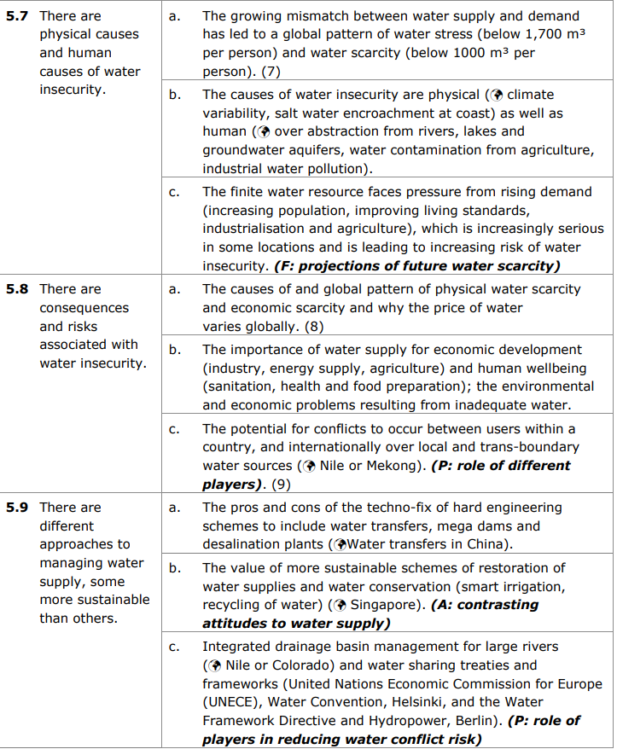
Lessons 12-19
You must understand the concept of water security here. It is definitely worth memorising a definition of water insecurity, water stress and water scarcity.
Explain the causes of water insecurity (8)
Explain why there is an increasing global demand for water (8)
Assess the causes of water insecurity (12)
Assess the risks of water insecurity (12)
Evaluate the view that humans increase the risk of water insecurity more than physical factors (2)
Explain why the price of water varies globally (8)
Explain how conflict over trans-boundary water sources can occur (8)
Evaluate the consequences of water insecurity (20)
Evaluate the causes of global water insecurity (20)
5.9 is very similar concept to 2b11 and 2b12 of coasts – coastal management.
You must know the difference between hard engineering schemes (dams, south to north water transfer in China and Desalination in Israel) compared to sustainable schemes e.g. Singapore and Integrated management e.g. Nile and Colorado and the role of the Berlin Rules in maintaining the integrated management case studies.
Explain how water can be managed through hard engineering techniques (8)
Explain how water can be managed sustainably (8)
Explain how water can be managed through integrated drainage basin management (8)
Explain how treaties and frameworks can be used to manage water (8)
The 8 markers above you must only refer to the case studies you need to – do not confuse them.
For 20 markers shown below – you can select a range of case studies depending on your argument. I would suggest comparing Hard engineering strategies to either sustainable or integrated drainage basin management schemes
Evaluate the success of approaches to managing water insecurity (20)
Page 58-72

Slide 28
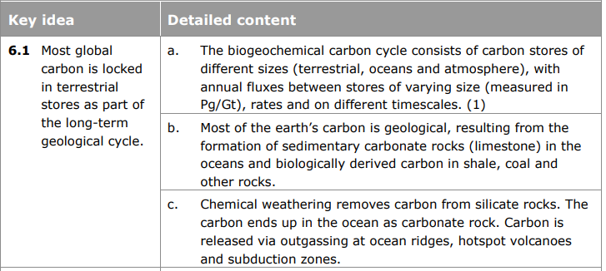
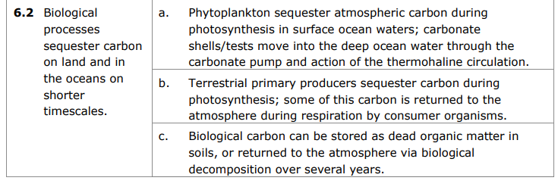
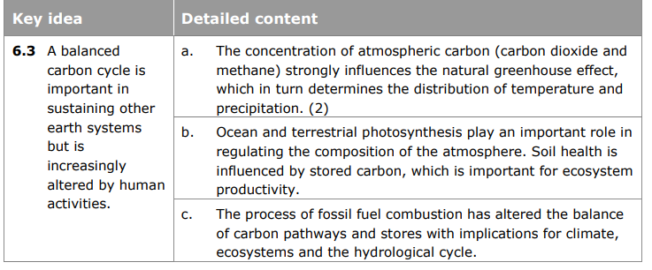
Lesson 1-5
Revise content here – Understand how the carbon cycle can be separated into terrestrial, oceans and atmospheric stores and understand the fluxes and size and residence times between stores.
Important that you are able to understand the role of phytoplankton, the carbon pump and the thermohaline circulation and how all three sequester carbon is important. Revise the role ocean (phytoplankton) and terrestrial (tropical rainforest biomes) regulate the carbon cycle is important also.
Remember the sequestration of carbon in oceans (phytoplankton) and land (trees) does not happen everywhere – phytoplankton live by shallow coastal areas (and are threatened by human activities there as well as warming oceans, they cannot survive in warming oceans). Terrestrial sequestration occurs mainly in tropical rainforests – which indeed are being threatened by human activities namely deforestation and urbanisation. You must also understand how biological carbon can be sequestered (think Gersmehl model from GCSE!)
Explain how phytoplankton sequester carbon (6)
Explain how carbon is sequestered (6)
Explain the importance of fluxes to the carbon cycle (3)
Assess the importance of phytoplankton in sequestering carbon (12)
Assess how human activities unbalance the carbon cycle (12)
Explain how plants help to maintain a balance in the carbon cycle (6)
Explain how the thermohaline circulation helps regulate the carbon cycle (6)
Explain how fossil fuel combustion has altered the balance of carbon in the carbon cycle (6)
Assess how human activities have unbalanced the carbon cycle (12)
Page 80-90

Slide 29
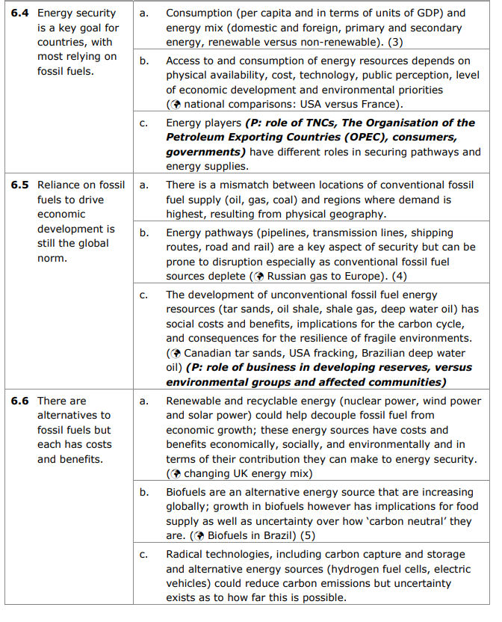
Lesson 7 – 13
Key concept: Energy security – know a definition
Case study: Canadian tar sands for 6.5c
UK energy mix 6.6a
Biofuels case study for 6.6b
Explain the role of energy players in securing energy pathways and energy supplies (8)
Explain why there is a mismatch between locations of conventional fossil fuels and location of consumption (8) – could be a map based question
Explain why renewable energy sources have costs in terms of their contribution to energy security (8)
Explain why energy pathways may be prone to disruption (8)
Explain why countries energy mix can vary (6)
Assess the physical and human factors which enables energy security for countries relying on fossil fuels (12)
Assess why reliance on fossil fuels are still the global norm (12)
Evaluate the development of unconventional fossil fuel resources as a solution to energy insecurity (2)
Evaluate the benefits and costs to alternatives to fossil fuels (20)
Evaluate why countries still rely on fossil fuels rather than alternatives to fossil fuels (20)
Pg 92-110 textbook

Slide 30
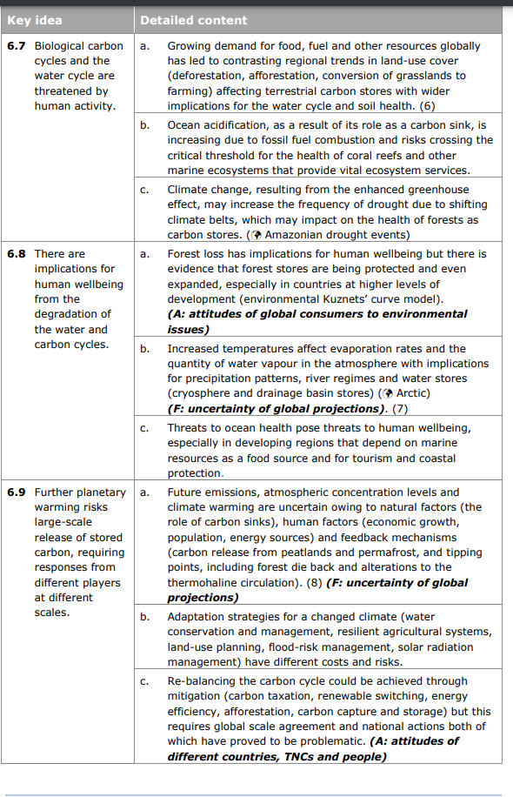
Lesson 14-19
Sections 6.7 and 6.8 involve a lot of content which needs to be understood before attempting questions. I would recommend following pages in textbook and making detailed notes. The questions from this section can be worded difficultly.
6.8 and 6.9 can combine both carbon and water cycles content. As such they could be likely 20 mark questions e.g.
Evaluate the implications for human wellbeing from the degradation of the water and carbon cycles (20)
Evaluate the view that we have reached a point of no return in the degradation of the water and carbon cycles (20)
Evaluate the responses from key players to the increasing release of stored carbon (20)
Evaluate the responses from different players to the threat of a large-scale release of stored carbon (20)
Assess the impact of forest loss on human wellbeing (12)
Assess how increased temperatures can have implications for precipitation patterns (12)
Assess how threats to ocean health pose a threat to human wellbeing (12)
Explain how climate change may increase the risk of drought (8)
Explain how an increase in drought frequency may affect forests as carbon stores (8)
Explain why there is uncertainty in the projections of future atmospheric co2 concentrations (8)
Explain the impacts on the biological carbon cycle as a result of human activity (8) – refer to impacts such as ocean acidification, forest loss, soil health…)
Pg 111-128 textbook

Slide 31
Paper 2
Regeneration (35 marks)
Superpowers and Globalisation (32 marks)
Health and Human Rights (38 marks)
Do not answer questions on ‘Diverse Places’ and ‘Migration, Identity and Sovereignty’.

Slide 32

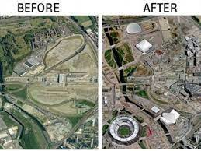
Regeneration – 35 marks (3, 6, 6, 20)

Slide 33
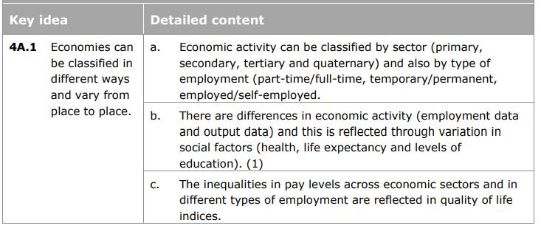
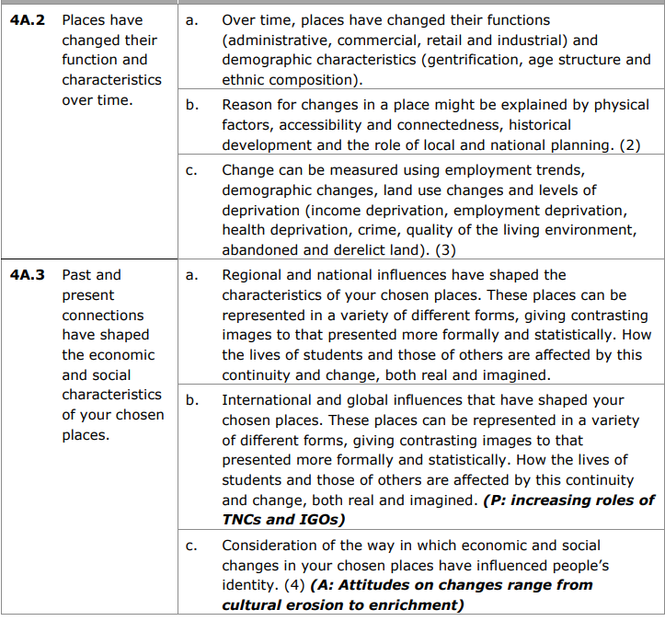
Lessons 1, 2 and 3
Revise the Clark-Fisher Model – this shows how economic activity in an area changes over time (4a.1b), you could bring in your understanding of this in any exam question.
The spec areas highlighted require you to know ‘reasons’ so this could lead onto a six mark question such as:
Explain the reasons for change in economic activity (6) (4a.1b)
Explain the physical factors for changes in a named place (6) (4a.2b)
Explain how change in the characteristics of a place can be measured (6) (4a.2c)
Explain the regional and national influences that have shaped a named place (6) (4a.3a)
Explain how a named place has changed economically and socially (6) (4a.3c)
You could receive some more general questions based on this content such as:
Explain why employment factors may create variations in the quality of life between places (6)
Outline one reason why the function of a place might change over time (3)
The named place that is taught to you for 4.a3 is East London – within this case study we teach you about Bethnal Green, Stratford and Barking and Dagenham. All these three locations could be referred to here under the ‘East London’ named place.
Page 224 -234 (other case studies are present in textbook, feel free to use them instead)
There is an opportunity here for 3 mark ‘skills’ questions. Page 232 and 227 have some useful activities to prepare you for this.
Be clear on the content here and reasons for change.

Slide 34
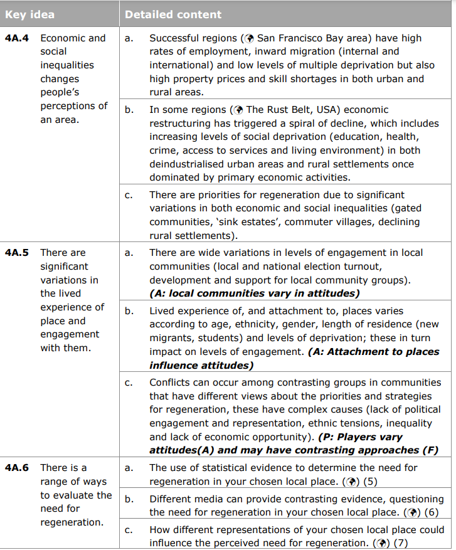
Lessons 4, 5, 6 , 7, 8, 9, 10, 15
Successful place case study: Sydney and M4 corridor
Unsuccessful place case study: Middlesbrough and Beatyville USA
Evaluating the need for regeneration case study: You should refer to East London as your chosen place (you can also reference examples from Middlesbrough or Beatyville). Lesson 15 also provides information on the statistical evidence for regeneration on East London.
‘Lived experience’ is an important concept – know what it means and the factors which affect it. Also consider that different stakeholders have different lived experiences in a place. Lived experience can also be affected by the representation of place in the media.
4A.5 and 4A.6 did not come up in 2021 (doesn’t mean it will this year)….but, it could lead to some questions which are worded difficultly – see below
Outline what is meant by lived experience (3)
Explain why some places are more successful than others (6)
Evaluate the reasons why some places are successful and others are not (20)
Explain how social and economic inequalities changes people’s perceptions of an area (6)
Explain why community engagement in a place varies (6)
Explain how lived experience varies (6)
Explain how lived experience impacts community engagement (6)
Explain the priorities for regeneration in your chosen place (6)
Explain why employment factors may create variations in quality of life between places (6)
Explain how the media can provide evidence for the need of regeneration in a place (6)
Evaluate the reasons why the lived experience of a place varies (20)
Evaluate the impacts of lived experience on community engagement in your chosen place (20)
Evaluate the need for regeneration in your chosen local place (20
Evaluate the view that different representations of a place can influence the perceived need for regeneration (20)
Page 235-247

Slide 35
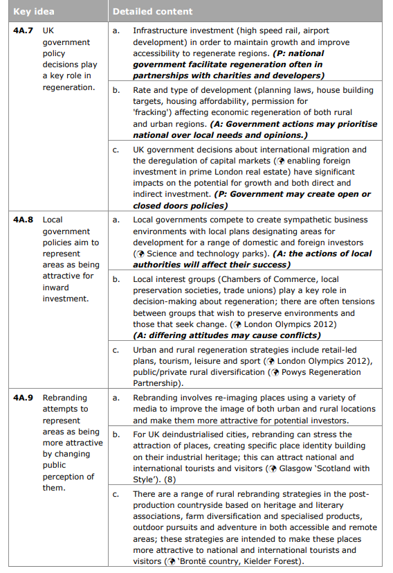
Lesson 11, 12, 13, 14, 16, 17
This section lends itself more to 6 mark question than 20 mark but a 20 mark question could come up. See below.
Explain the policy decisions that play a key role in regeneration (6)
Explain how the UK government plays a key role in regeneration (6)
Explain how the national governments facilitate regeneration in partnerships with charities and developers (6)
Explain how national and local governments play a key role in facilitating regeneration (6)
Explain how the UK government may create open or closed door policies to facilitate regeneration (6)
Explain how the deregulation of capital markets affects growth and investment (6)
Explain how rebranding can make areas appear more attractive for investment (6)
Revise the key ways in which national and local governments play a role in regeneration. Look at the specification ideas and expand on them.
A 20 mark question could also come up here:
Evaluate the role of national and local governments in facilitating regeneration (20)
Evaluate the success of local government policies which aim to attract inward investment to rural areas (20)
Evaluate rebranding strategies you have studied (20)
Revise the regeneration schemes – Glasgow for rebranding (lesson 12), Cornwall for rural rebranding (lesson 13), North Antrim for rural regeneration (lesson 17) and Barking and Dagenham (lesson 14) and Stratford (lesson 16) both for urban regeneration . All are useful case studies to make notes on the role that the local and national government played in each of the five regeneration schemes listed above. Remember to use examples to support your points within a 6 mark question
There is an argument that nationally, the UK government is more concerned with urban regeneration (particularly in the south e.g. London) compared to elsewhere. Creating a north-south divide.
Page 248-260 has really useful information

Slide 36
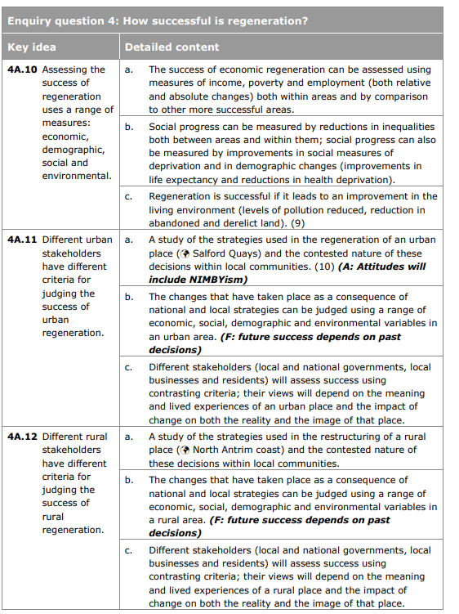
Lesson 12, 13, 14, 16, 17
This section is all about ‘criteria for judging success’ of regeneration schemes. There is the need for rural and urban schemes.
Case studies
Rural: Cornwall and North Antrim
Urban: Glasgow, Stratford and Barking and Dagenham
Know what the criteria for the success of each case study is. i.e. what evidence is there for judging the success of schemes. Make sure you are able to evidence whether each case study is successful or not.
Remember – stakeholders will have different criteria for judging the success of regeneration because they have different vested interests/perspectives/priorities for that area. Know who the stakeholders are and how they judge the success of the scheme.
e.g. Will a resident of Carpenter’s Estate have the same opinion on the success of regeneration of Stratford as Newham Council? NO. Why? Social cleansing in Carpenter’s Estate.
Evaluate the different criteria used by stakeholders for judging the success of rural and urban regeneration schemes (20)
Evaluate the criteria used by stakeholders in judging the success of urban regeneration schemes (20)
Evaluate the criteria used by stakeholders in judging the success of rural regeneration schemes (20)
Evaluate the success of regeneration in urban and rural areas (20)
Evaluate the view that regeneration schemes are more successful in urban areas compared to rural (20)
Evaluate the success of regeneration in urban areas (20)
Evaluate the success of regeneration in rural areas (20)
If you receive a question on urban and rural. Think, your answer may vary according to rural vs urban. There is an argument that nationally, the UK government is more concerned with urban regeneration (particularly in the south e.g. London) compared to elsewhere. Creating a north-south divide. Does this mean urban schemes are more ‘successful’ to stakeholders than rural?
Remember any ‘management’ scheme is only successful if all stakeholders are included (holistic)
Page 261-266 (although case studies are different to some degree)

Slide 37


Superpowers and Globalisation – 32 marks (4, 12 – Superpowers) (4, 12 – Globalisation)

Slide 38
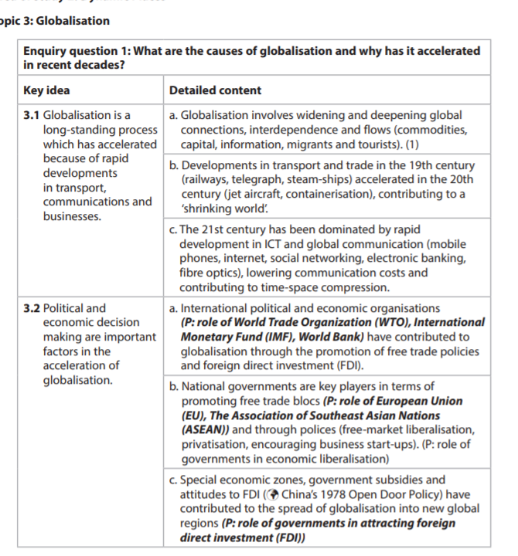
Lesson 1, 2, 3, 4, 5, 6, 7
There will be a four mark question and a 12 mark question in this section. The four mark question could be anything from a skills question to an explain question.
E.g.
Explain one political and one economic factor which has accelerated globalisation (4)
Explain two factors which have accelerated globalisation (4)
Explain two political factors which have accelerated globalisation (4)
Explain two economic factors which have accelerated globalisation (4)
12 mark questions will be ‘assessed’ based:
Assess the factors which have accelerated globalisation (12)
Assess the political and economic factors which have accelerated globalisation (12)
Assess the political factors which have accelerated globalisation (12)
Assess the economic factors which have accelerated globalisation (12)
Assess the role of key players/IGOs in accelerating globalisation (12)
Revise all content listed in the specification here. Pay close attention to ‘named examples’ you could use within any 12 mark question e.g. China’s 1978 Open Door Policy/SEZ and the role of key players e.g. WTO, IMF and World Bank and Trade Blocs.
Remember if the question is anything around what is italicised above – don’t refer to only what the question is asking. For all italicised questions above you must refer to all factors which accelerate globalisation: political, economic and key players.
Page 174-182

Slide 39
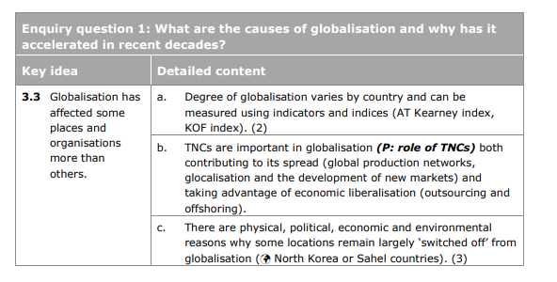
Lesson 8, 9, 10 and 11
3.3 could lend itself more to skills based content.
3.3a has never come up – I suspect if it did, it would be in table form with you required to complete a table and infer relationships etc. Page 183 of your textbook clearly explains 3.3a.
Make sure you know how globalisation can be measured.
Explain two indices which can be used to measure globalisation (4)
Know what is meant by ‘economic liberalisation’ and ‘glocalisation’
Define economic liberalisation (1)
Explain how economic liberalisation can be used by TNCs to help the spread of globalisation (3)
Define glocalisation (1)
Explain how glocalisation can be used by TNCs to help the spread of globalisation (3)
Support the explain questions above with clear examples.
Explain why some locations remain switched off from globalisation (4)
Assess the reasons why globalisation has affected some places and organisations more than others (12)
Know case studies for switched off locations e.g. North Korea, Himba Tribe
Pg. 183 - 187

Slide 40
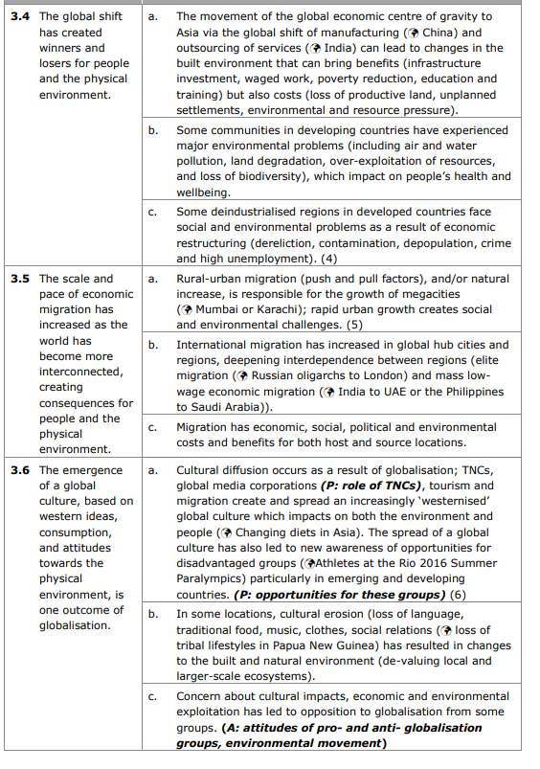
Lesson11 – 16
There is a lot of ‘content’ to be understood in this section before attempting any questions.
Know what is meant by the global shift (lesson 11) and its links particularly to the case studies of India and China. This could lend itself to a 12 mark question.
Assess the view that the global shift has created more winners than losers (12)
Assess the impacts of the global shift in developing countries (12)
Explain the social and environmental problems experienced in deindustrialised regions as a result of economic restructuring (4)
Explain why globalisation has caused change to built environments in economically emerging countries (4)
Assess the view that the pace and scale of economic migration has created severe consequences for the physical environment (12)
Assess the impacts that global migration has had on people and the environment (12)
Assess the benefits and costs for both host and source locations of economic migration (12)
Know what is meant by ‘cultural diffusion’ and the role TNCS play in spreading this.
Assess the view that the emergence of a global culture is a bad thing (12)
Assess the impacts of globalisation on culture (12)
Assess the contribution of globalisation to cultural diffusion (12)
Assess the economic and environmental impacts of globalisation (12)
Pg 188-199

Slide 41
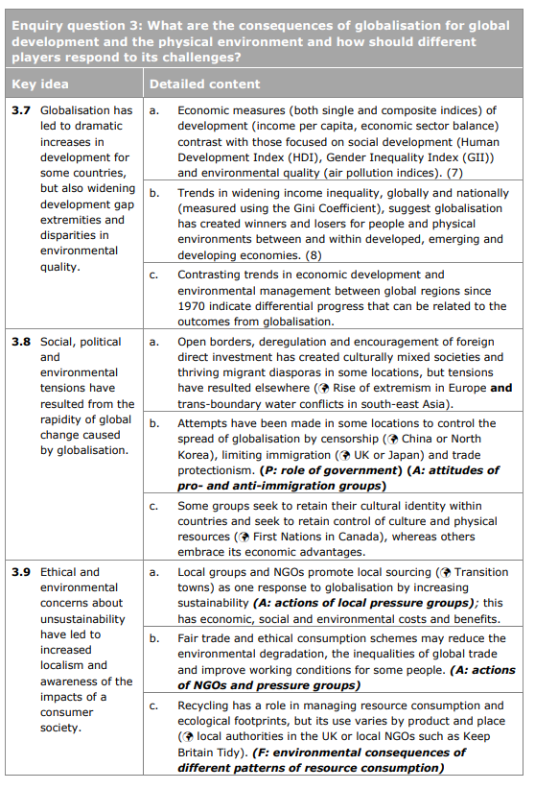
Lessons 17 - 20
Assess the view that globalisation has increased the global development gap (12)
Assess the tensions which have resulted from globalisation (12)
Assess the view that globalisaton has increased localism and awareness of the impacts of a consumer society (12)
Assess the view that globalisation has created more winners than losers (12)
Assess the actions taken by NGOs and local government in promoting ethical and environmental concerns about unsustainability (12)
3.7a could lead to a skills based question – see page 201 – 205 in textbook. Revise the Lorenz curve and GINI coefficient as well as HDI and GII
Explain how the GINI index can show a widening development gap (4)
Remember whilst globalisation has increased the development gap – there are other factors at play – think superpowers and human rights…also think about the role of policies set by governments….
Page 200 – 215

Slide 42
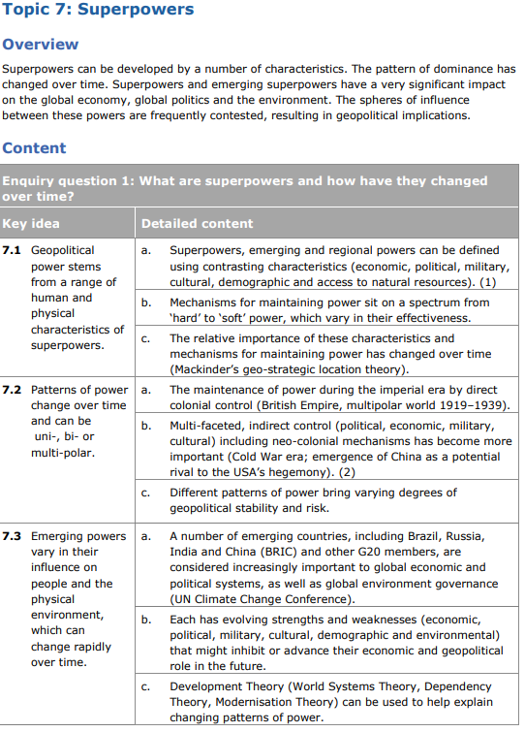
Lessons 1-5
You must understand what hard and soft power is and examples. If it doesn’t involve war/invasion/extreme economic sanctions to maintain power it is likely to be soft power.
Understand the theories of power and how it can help explain changing patterns of power- remember not all theories are relevant today and there are limitations to these theories.
Explain what is meant by hard power (2)
Explain what is meant by soft power (2)
Explain how hard and soft power can be used by superpowers (4)
Assess the role of hard power used by superpowers to maintain influence over other nations (12)
Explain two development theories (4) (you must refer to either: world systems theory, dependency theory or modernisation theory)
Explain how globalisation has led to a multipolar world (4)
Assess the view that we now live in a ‘bi-polar’ world in terms of superpowers (12)
Assess the extent to which China can claim to be a superpower (12)
Assess the extent to which neocolonialism affects geopolitical stability (12)
Page 136-149

Slide 43
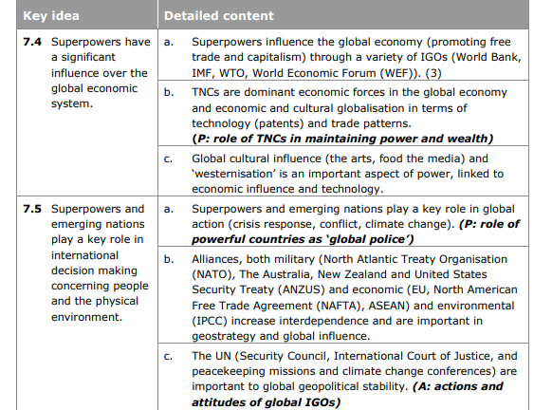
Lessons 6-9
You must understand the role that IGOs (named examples in spec) and TNCs play in supporting superpowers (and indeed globalisation).
Assess the role of superpowers in influencing IGOs (12)
Assess the role of superpowers in influencing IGOs and TNCs (12)
Assess the influence of superpowers in influencing the global economic system (12)
Assess the role of superpowers in global decision making (12)
Explain how the system of intellectual property law benefits the current superpowers (4) – remember a significant number of innovative TNCs e.g. Apple are American!
Explain why military alliances are an important part of international decision making (4)
Assess the extent to which superpowers influence action on global environmental concerns (12)
Assess the extent to which BRICs influence action on global environmental concerns (12)
Pg. 150 – 161

Slide 44
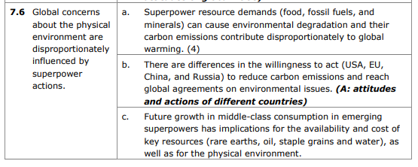
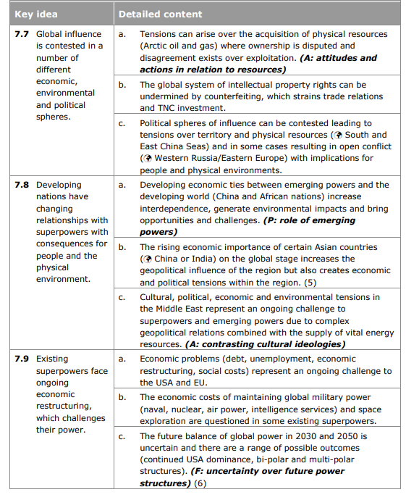
Lesson 9, 10, 11, 12, 13, 14, 15
There will be a four mark question and a 12 mark question in this section. The four mark question could be anything from a skills question to an explain question.
E.g.
Explain two impacts that superpower actions can have on the environment (4)
Outline how the growing middle class can have implications on the availability of resources (3)
Explain how geopolitical tensions can arise between superpower nations (4)
12 mark questions will be ‘assessed’ based:
Assess the impacts that developing nations can have on the physical environment (12)
Assess the tensions that can arise as a result of the contest for global influence of superpowers (12)
Assess the social and physical consequences of superpower actions (12)
Assess the social consequences of superpower actions (12)
Assess the physical consequences of superpower actions (12)
Assess the view that economic problems faced by superpowers challenges their power (12)
Using examples, assess the ways in which global influence may be contested politically (12)
Assess the extent to which the position of USA as a uni-polar superpower is being questioned (12)
There is a real focus on ‘impacts’ and ‘tensions’ that superpower actions can have. Revise case studies of Russia/Ukraine, The Middle East and Arctic oil and gas. There is a range of spheres of influence that is contested: Seas (Russia/Ukraine and Arctic Oil and Gas) and Land (the Middle East). Consider: who is contesting and why?
Your answers for ‘why’ are invariably to maintain a sphere of influence by superpower nations (USA, China, Russia) and to maintain control of fossil fuels which is what the governments of these countries use to maintain their strong economic growth and subsequent superpower status.
Remember if the question is anything around what is italicised above – don’t refer to only what the question is asking. For all italicised questions above you must refer to all factors.
Page 150 – 172
There is a useful resource based question on page 164 – although it would not be a 6 mark question rather a 4 mark question.

Slide 45


Health and Human Rights – 35 marks (4, 6, 8, 20)

Slide 46
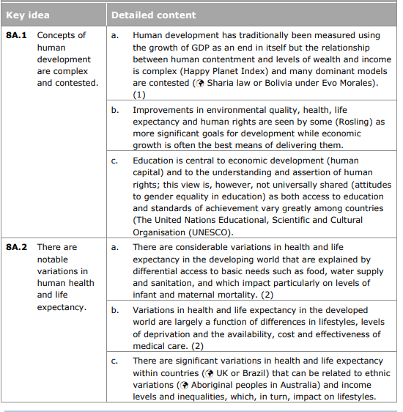
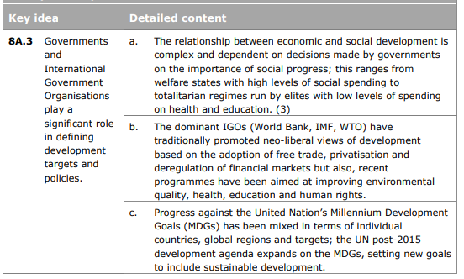
Lessons 1 - 6
To me, 8a1 and 8a2 lend itself to a 4 mark skills question, this could be plotting data or indeed some form of skills test.
6 mark questions:
Explain the reasons for variations in health and life expectancy (6)
Explain the reasons for variations in health and life expectancy in developed and developing nations (6)
Explain the reasons for variations in health and life expectancy in developing nations (6)
Explain the reasons for variations in health and life expectancy in developed nations (6)
Explain how education is a vital for economic development (6)
8 mark questions:
Explain the role that governments and IGOs play in defining development targets and policies (8)
Explain how there are variations in health and life expectancy between and within nations (8)
Explain why many view education as central to enabling the economic development of countries (8)
20 mark questions:
Evaluate the reasons for variations in health and life expectancy between developed and developing nations (20)
Evaluate the role that governments and IGOs play in defining development targets and policies (20)
Page 188-209
There are useful graphics here – you can see that this section could lend itself to a resource based question e.g. page 205 and 198-199

Slide 47
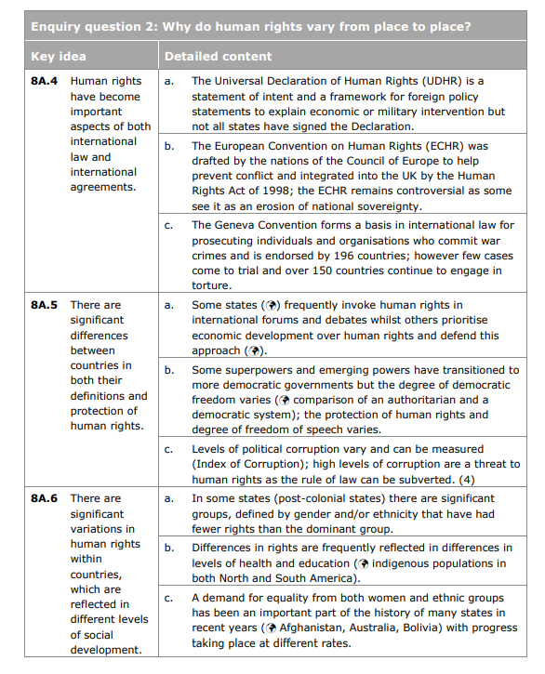
Lesson 8, 9, 10, 11, 12
Know the ECHR and specific examples of human rights which are protected (good examples to use in a relevant question)
6 mark questions:
Explain how the ECHR can be used to protect human rights (6)
Explain how human rights are protected in international laws and agreements (6)
8 mark questions:
Explain the role of democracy and political freedom in the protection of human rights (8)
Explain why the protection of human rights varies between countries (8)
Explain how corruption can threaten human rights in countries (8)
Evaluate:
Evaluate the reasons why there are significant differences between countries in the definitions and protection of human rights (20)
Evaluate the success of international agreements which can protect human rights (20)
Evaluate the view that more democratic nations have a better protection of it’s human rights (20)
If asked to evaluate why there are significant variations of definitions and protections of human rights think about the following:
Whose human rights are being protected (sometimes protecting a nations human rights can lead to abuses of human rights in another country…e.g.. War)
Gender – some nations unfortunately do not protect genders equally
Race – think of Rwandan genocide – groups within the same country had different protection of their human rights
Corruption – see below
Level of democracy (this is an interesting one…USA deemed one of the most democratic nation … but there are a lot of human rights abuses committed by USA on other countries… food for thought)
Ultimately – remember this: A superpower nation’s priority is more often than not – economic growth. A superpower will ultimately choose to progress its economic growth at the expense of human rights
If you are going to use the word ‘corruption’ in any answer … you must support with statistical evidence of corruption …. In other words use data from the index of corruption. Common examples of nations which are deemed corrupt and relevant to your course are Haiti (tectonics) = 164/180 (1 being the least corrupt nation and 180 the most corrupt) and Afghanistan 174/180.
Page 210 - 219

Slide 48
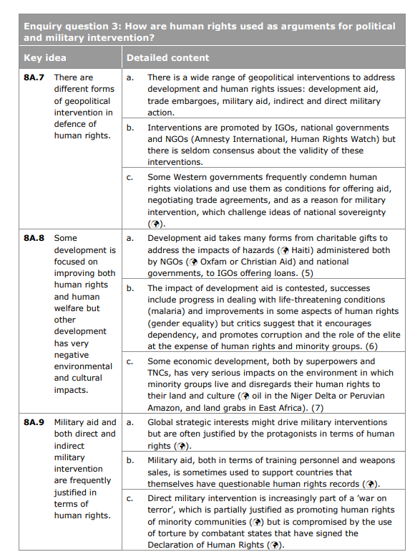
Lesson 13 - 19
This section lends itself to key concepts of ‘geopolitical intervention’ and ‘military intervention’. And in particular, judging the success of such interventions. This means that it could be more 12 and 20 mark questions in this section.
Note this content in 8a.7, 8a.8 and 8a.9 overlaps with content on next page. Questions can be found on the next page.

Slide 49
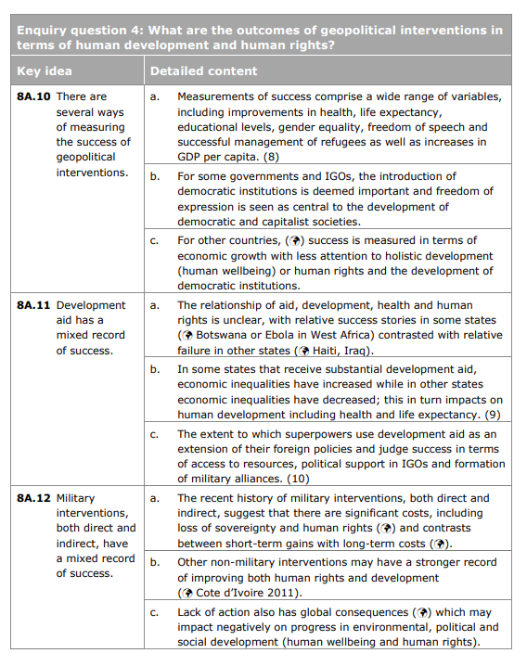
Lesson 13 - 19
This section lends itself to key concepts of ‘geopolitical intervention’, ‘development aid’ and ‘military intervention’. And in particular, judging the success of such interventions. This means that it could be more 12 and 20 mark questions in this section.
Case studies
Aid: Haiti, Ebola in Western Africa, Niger Delta (Lesson 18)
Military interventions: USA/IRAQ, Russia/Ukraine, Iran, Libya, War on Terror (Lesson 16)
Non-military interventions: Timor Leste, Zimbabwe (Lesson 19)
Case studies do not have to be ‘detailed’ but know specific statistics/data relevant for each case study. There is a big focus on ‘measurements’ of success so for each case study you must know: was it a success? How/in what ways was it a success? What data do you have to support this?
Explain:
Explain the range of geopolitical interventions used to address development issues (8)
Explain the range of geopolitical interventions to address human rights issues (8)
Explain the ways of measuring the success of geopolitical interventions (8)
Explain why there may be long-term costs as a result of direct and indirect military intervention (8)
Explain why some countries place economic development before human development (8)
Explain why military interventions are often contested (8)
Explain how superpowers use development aid as an extension to their foreign policies (8)
Explain how superpowers can judge the success of military aid (8)
Explain why there are long-term costs associated with direct and indirect military action (8)
Assess:
Evaluate:
Evaluate the view that direct Military interventions can have a mixed record of success (20)
Evaluate the mixed record of success of indirect military interventions (20)
Evaluate the mixed record of success of military interventions (20)
Evaluate the impacts of a lack of action of geopolitical interventions (20)
Evaluate this statement: Direct military intervention is not a successful method of geopolitical intervention of human rights (20)
Evaluate the criteria for measuring the success of geopolitical interventions (20)
Evaluate the strategies used by governments and IGOs to measure the success of geopolitical interventions (20)
Evaluate the view that development aid has a mixed record of success (20)
Evaluate the view that development aid supports human rights more successfully than military intervention (20)
Evaluate the statement: some developments improve human rights and welfare, whilst others have negative environmental and cultural impacts (20)
Evaluate the justification given for military aid and intervention in the defence of human rights (20)
Evaluate the view that indirect interventions are always preferable to direct military interventions (20)
Read the specification areas carefully, the reasons are given to you. You just need to ‘flesh out/provide further detail’.
For 20 mark questions – re the ‘mixed record of success’ think that invariably your answer will vary spatially. Is success determined whether the military action is direct or indirect? Is success determined whether there are abuses of human rights? Is success determined by superpower nations and how they act on the matter? What are the reasons behind development aid, who does it really benefit (think tied-aid)?
Know specific human rights (from the declaration of human rights) and evidence them in your argument for a 12/20 mark question. Page 210-213
Page 220-249

