Slide 1

YEAR 11 GCSE EXAMS
SUMMER 2026

Slide 2
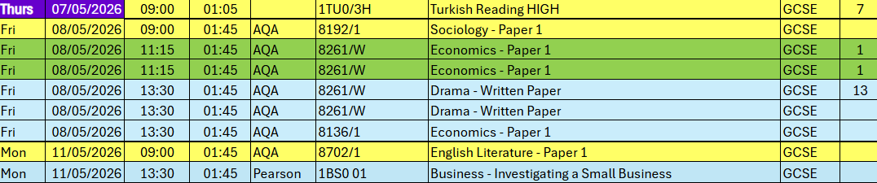
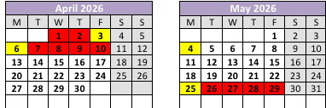
Don't forget bank holiday monday!

Slide 3
In School Targeted Revision and Masterclasses
01
There will always be targeted revision masterclasses with your teachers before every exam
This will support the revision you are doing at home
The revision masterclasses will be exam focused and based on your specific areas that you need to recap
The revision masterclasses begin on the 7th May

Slide 4
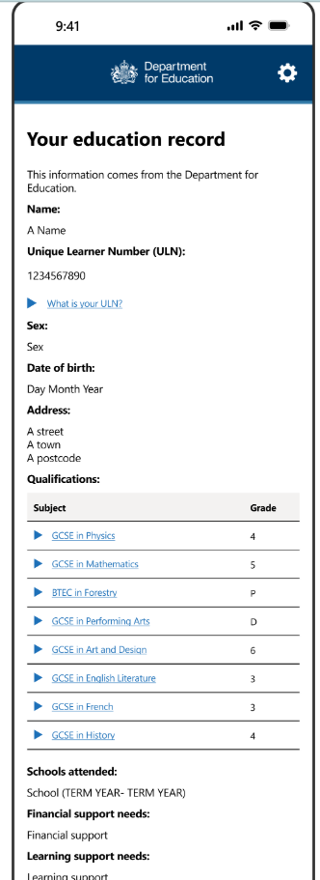
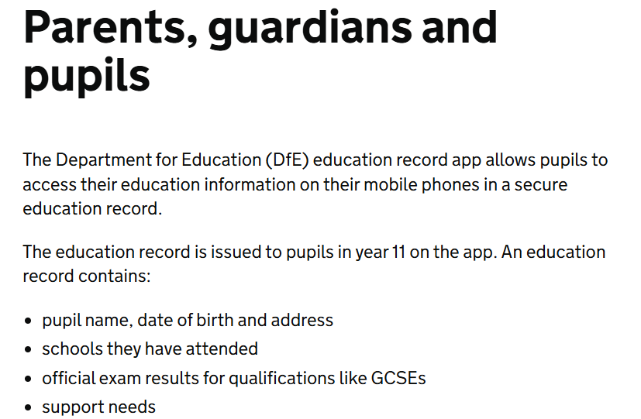

Slide 5
Things you need to know
01
Timing & Arrival
05
Missing an Exam
When to be at school and what happens if you are late
The consequences of non-attendance
02
Checking Your Seat Number
06
Equipment
How to find your assigned seat before the exam
What to bring and what is not allowed
03
Lining Up & Entering the Hall
07
Correct Uniform
The process for entering the exam room
Full uniform required, including footwear
04
Planning Your Journey
Giving yourself enough time – no rushing!

Slide 6
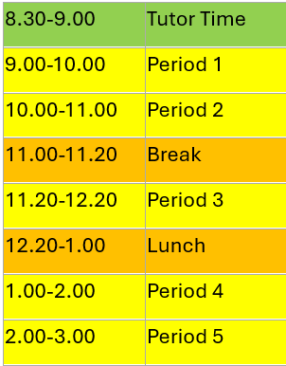

Changes to the school day
This will begin on Tuesday 5th May and end on Friday 12th June
These changes are to ensure you can eat and hydrate before any afternoon exams.
Notes:
Joint council for qualification

Slide 7
The Essentials
All exams are subject to JCQ rules and regulations
Information for candidates – Joint Council for Qualifications
Be on time with a black pen and no phone on your person
Notes:
Joint council for qualification

Slide 8
When are my exams?
01
Timetables are available on paper or electronically (Edulink)
Check your name and date of birth are correct
Ensure all your subjects are present and tiers are correct
Learn and remember your candidate number
Save the timetable to your phone
Make as many copies as you need and keep one with you

Slide 9
What do I need to bring?
01
Yourself – be on time and in the right seat
Black pen plus spares
Water bottles must be transparent with no labels
Calculators cannot have lids
Pencil cases must be transparent
Correct equipment for EVERY exam

Slide 10
Timing & Arrival
01
Arrive at school at least 30 minutes before the exam start time
30
Morning exams typically start at 9:00am — be in school by 8:30am
MINUTES EARLY
Afternoon exams typically start at 1:00pm — be back from lunch early
minimum arrival before
your exam starts
If you are late, go to Reception first — do NOT go to the hall
More than 30 minutes late? You may NOT be permitted to sit the exam

Slide 11
Lining Up & Entering the Hall
03
✓ DO
✗ DON'T
✓ Wait Silently in forms in the designated line outside the hall
✗ Talk or socialise while waiting in line
✓ Have your timetable/candidate number ready
✗ Bring bags or coats into the hall (leave as directed)
✓ Belongings will be kept in the staffroom
✗ Have your mobile phone on your person
✓ Follow instructions from invigilators immediately
✗ Wear a smartwatch or any watch into the exam room
✓ Enter the hall silently and go directly to your seat
✗ Enter the hall before you are told to
✓ Remain silent from the moment you enter the hall
✗ Sit at any desk other than your assigned one

Slide 12
Planning Your Journey to School
04
Your Pre-Exam Morning Checklist
Don't leave it to chance.
📋 Check your timetable the night before
Exams are the most important days of your school year. Treat the journey to school like part of the exam — plan it carefully.
Buses can be late. Trains are cancelled. Alarm clocks fail.
Build in extra time. Always.
🎒 Pack your bag the night before — all equipment
⏰ Set TWO alarms — don't rely on one
🥣 Eat breakfast and leave home earlier than usual. Breakfast is also available at school.
🚌 Know your bus/route and have a backup option
📞 If something goes wrong — call school
If you are going to be late: call the school office as soon as possible so the Exams Team can be informed.

Slide 13

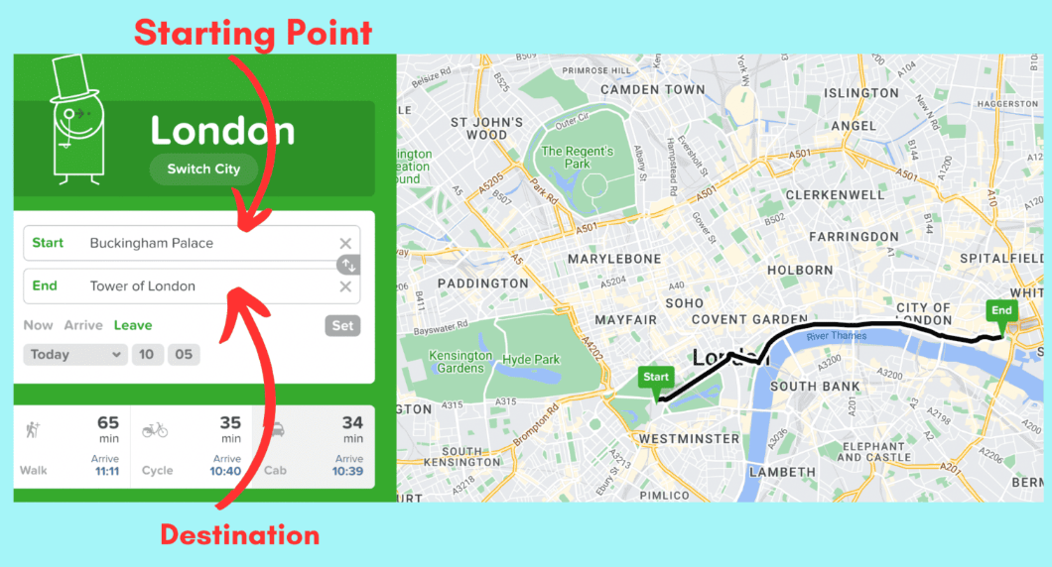
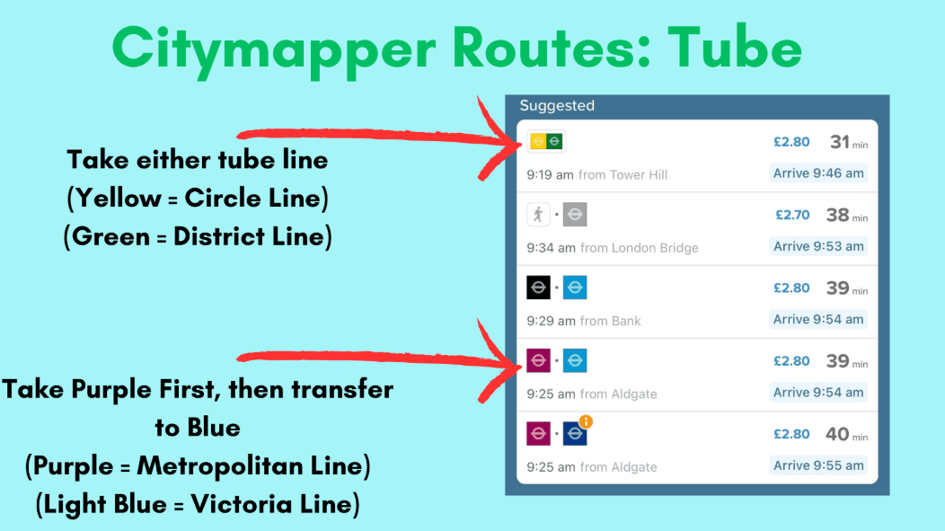
Live updates
Enter your start/finish postcodes
Alternative routes during delays etc
All forms of public transport

Slide 14
⚠ Missing an Exam
05
Consequences
If You're ill or Have an Emergency
✗ You WILL receive a grade of 0 for that exam component
1
Phone school FIRST THING in the morning
2
Obtain a doctor's note explaining the reason
✗ Misreading the timetable is NOT an acceptable excuse
3
Submit the doctor's note within 4 days of the last component
✗ Missing exams could affect your final grade or whole qualification
4
If you feel unwell but can travel, come in and we'll assess
✗ University/sixth form offers may be affected
5
If in doubt — PHONE US. The worst thing you can do is nothing.

Slide 15
Bringing the Right Equipment
Equipment will NOT be provided on the day. You are responsible for bringing everything you need.
✓ MUST BRING
✗ NOT ALLOWED
🖊 Black or blue ballpoint pen (bring spares)
🚫 Correction fluid, liquid paper or tape
✏️ Pencil and eraser (for diagrams/graphs)
🚫 Highlighters (in answers — only on question paper)
📐 Ruler (30cm, clear/transparent)
🚫 Notes, books or revision materials
🔢 Scientific calculator (if permitted — check timetable)
🚫 Calculator cases or instruction booklets
🔵 Compass and protractor (Maths exams)
🚫 Any pencil case that isn't clear/transparent
⚠ Pack your bag the night before — don't leave it until exam morning.

Slide 16

Calculator
Ensure you bring calculators for Maths papers 2 and 3.
You will also need it for all Science exams
Speak to Maths department if you need one

Slide 17
Just to reiterate
PHONES ARE NOT ALLOWED IN THE EXAM ROOM!
You will be disqualified
Even if the phone is in your pocket or on silent

Slide 18
Correct Uniform for Exams
YOU MUST BE IN FULL SCHOOL UNIFORM FOR EVERY EXAM — INCLUDING FOOTWEAR.
✓ What to Wear
✗ If You Don't Comply
👔 Full Forest Academy school uniform
🏠 You wast exam time
👟 Correct school shoes — footwear counts!
⏰ Lost time cannot be given back to you
🧥 School blazer/jumper as required
📋 Could affect your ability to sit the exam
🚫 No PE kit, hoodies or non-uniform items
⚠️ No exceptions will be made on the day
Check your uniform the night before — don't leave it as an afterthought on exam morning. You don’t need the extra stress!

Slide 19
Starting the examination
You are under exam conditions from the moment you enter the exam room
Keep silent with eyes facing the front and do not turn around
You cannot leave until the exam is over
Check you have the correct paper
Listen to instructions from the invigilators

Slide 20

Remember…
Bring a black pen!

Slide 21
End of the Exam
Make sure your name and number are on all sheets
Papers are collected BEFORE you are dismissed
Stay silent until you have left the exam room as you are still under exam conditions
Do not leave any belongings behind
Return any borrowed equipment

Slide 22
Behaviour
When you are in the exam hall, you are under exam conditions.
This means absolute silence
If you talk or make noises, you will be removed from the exam
You will get 0
Your hard work throughout your secondary school journey has been leading to this point.
Do not ruin it for yourselves.
Do not ruin it for others.

Slide 23
Quick Reminders for Every Exam
📵
No Mobile Phones
🖊
Bring Your Own Equipment
Turned OFF and in your bag. Found on you = possible disqualification. No exceptions.
Equipment will NOT be provided. You are responsible for pens, pencils, ruler, calculator.
⌚
No Watches
🚽
Use the Toilet Before
No watches of any kind are allowed in the exam room, including smartwatches.
Go before the exam. If you must go during, raise your hand — you will be escorted.
💧
Water Only
🔇
Silence at all times
Only clear water bottles allowed. No labels. No coloured liquids (unless pre-approved).
Silence from the moment you enter until you have left the building. You are still under exam conditions outside.

Slide 24
Just to reiterate
PHONES ARE NOT ALLOWED IN THE EXAM ROOM!
You will be disqualified
Even if the phone is in your pocket or on silent

Slide 25
Remember…
Bring a black pen!

Slide 26
The Forest Academy Year 11 Team
Remember:
✓ Arrive at least 30 minutes before your exam starts
✓ Check the seating list, find your desk, sit in silence
✓ Plan your journey — do not rush, do not leave it to chance
✓ No phones, no watches on your person
✓ If you are ill or there is an emergency — call school, immediately
Good luck, Year 11! We are proud of you!
You are ready!

