Slide 1
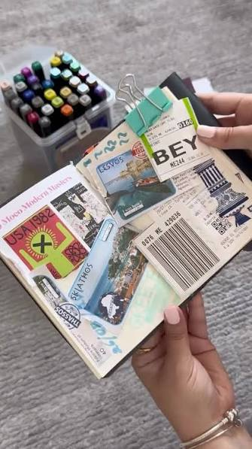
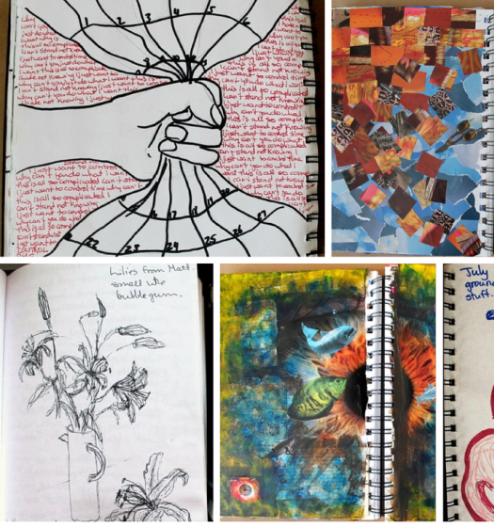
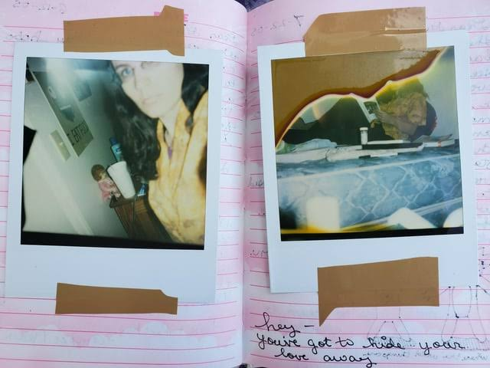
TRANSITION WORK-
GCSE FINE ART WITH PHOTOGRAPHY
As the starting point to your GCSE Fine Art, we would like you to create a personal record of your summer.
This should take the form of a small handmade journal and include the following:
-Photographs
-Sketches and other art materials recording
-Memorabilia from your summer, for example, tickets, receipts, etc
-Annotations, tell us about the events/places and things represented through photography and sketches.
This MUST represent you, think about decoration, colour themes etc, make it PERSONAL!!!!

