Slide 1

Mastering Data Visualization
Bar Charts, Line Graphs, and Lines of Best Fit

Slide 2

Learning Objectives
By the end of this session, you will be able to:
Construct accurate bar charts for categorical data.
Plot line graphs for continuous data over time.
Draw an appropriate line of best fit to identify trends.

Slide 3
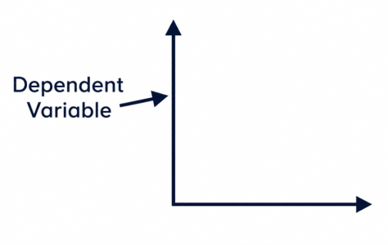
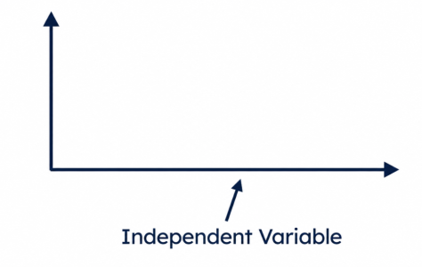
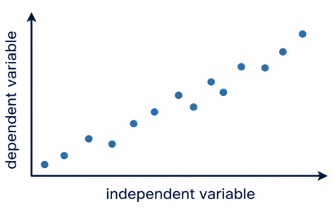
Key Vocabulary
Dependent Variable
The variable you measure (usually on the y-axis).
Independent Variable
The variable you change (usually on the x-axis).
Correlation
The relationship between two variables.

Slide 4
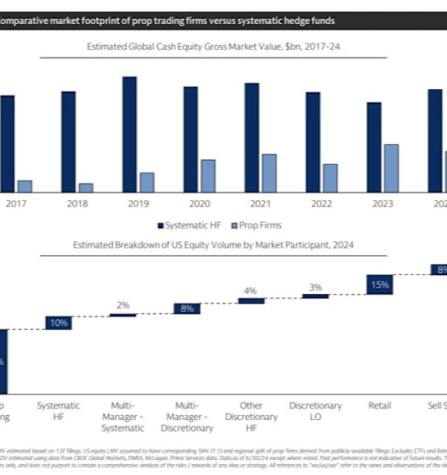
Why do we bother with graphs?
Imagine trying to find a needle in a haystack—that's what analyzing a table of 1,000 numbers feels like.
Graphs transform raw data into a visual story, allowing us to spot patterns, outliers, and relationships instantly. In your OCR GCSE, precision here is the difference between a Grade 5 and a Grade 9.
🔑
Key point
Always use a sharp pencil and a ruler. Accuracy is marked to the nearest half-millimetre.

Slide 5
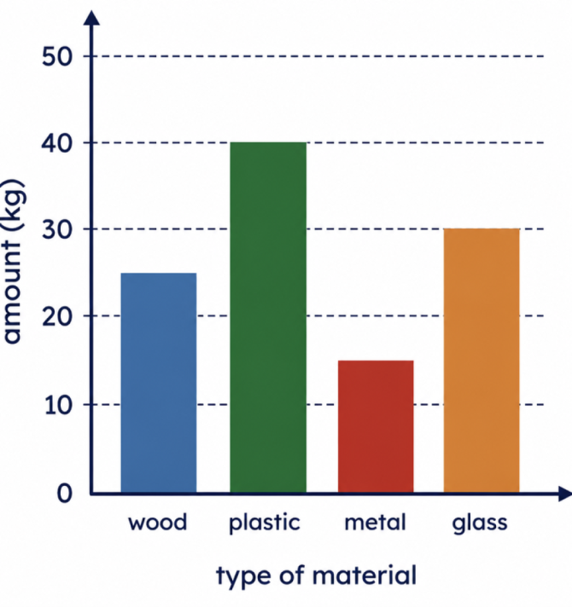
Constructing Bar Charts
CATEGORICAL DATA
Use bar charts when your independent variable is discrete (categories like 'Type of Material').
Equal Widths: Every bar must be the same width.
Gaps: Leave equal gaps between bars.
Labels: Ensure both axes are labeled with units.

Slide 6
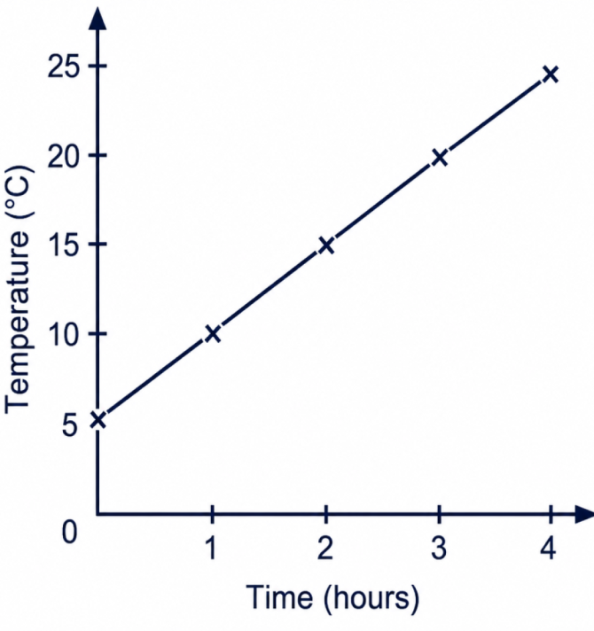
Plotting Line Graphs
CONTINUOUS DATA
Line graphs are for continuous data (e.g., Temperature or Time).
Plot points with small 'x' marks.
Connect points with straight lines only if you are showing a change over time.
If you are looking for a relationship between two variables, you likely need a Line of Best Fit instead.

Slide 7
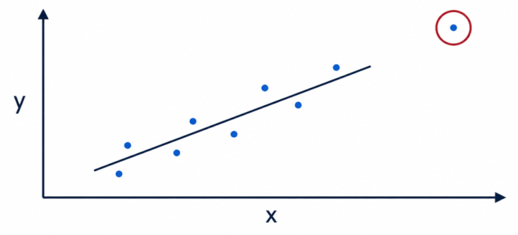
The Line of Best Fit (LOBF)
A Line of Best Fit shows the data trend; it does not need to touch every point.
Do's
Use a ruler.
Balance points above and below.
Ignore outliers.
Don'ts
Don't connect first and last points.
Don't force through (0,0).
⚠️
Watch out
If the trend is curved, draw a smooth curve.

Slide 8
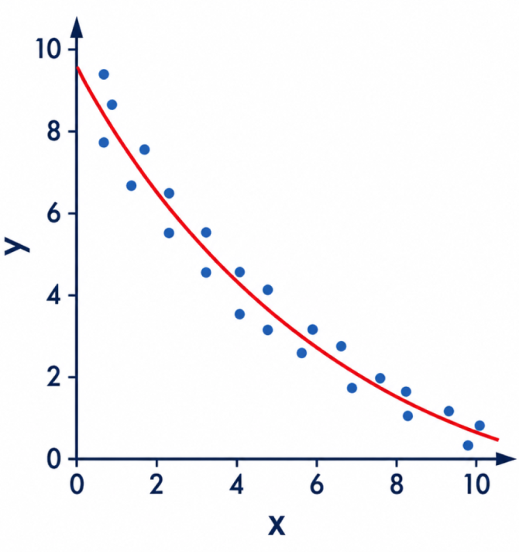
Drawing Curves of Best Fit
ADVANCED TECHNIQUE
Not all relationships are linear. If your data points show a clear arc or bend, forcing a straight line with a ruler will lose you marks. You must draw a smooth curve instead.
The 'Ghost' Trace
Before putting pencil to paper, move your hand in the air above the points to get the feel of the curve's natural flow.
Single Stroke
Avoid 'feathering' (short, hairy strokes). Try to draw the curve in one continuous, confident movement.

Slide 9
Knowledge Check: Bar Charts
Answers on the next slide...
Which of these is a requirement for a standard bar chart representing discrete categories?
1.
Points must be connected with a curved line.
2.
The x-axis must always show time.
3.
Bars must be different widths based on frequency.
4.
Gaps must be left between the bars.

Slide 10
Knowledge Check: Bar Charts
✅​
Which of these is a requirement for a standard bar chart representing discrete categories?
1.
Points must be connected with a curved line.
2.
The x-axis must always show time.
3.
Bars must be different widths based on frequency.
4.
Gaps must be left between the bars.
👍​

Slide 11
Applying the Line of Best Fit
A line of best fit must always pass through the origin (0,0).
👍​
👎​
TRUE
FALSE
Now it's time to explain why...

Slide 12
Applying the Line of Best Fit
A line of best fit must always pass through the origin (0,0).
👎​
Why is that?
a) It should only pass through the origin if it is physically possible for the dependent variable to be zero when the independent variable is zero.
b) The line of best fit must always start at the lowest data point provided in the table.
Answers on the next slide...

Slide 13
Applying the Line of Best Fit
✅​
A line of best fit must always pass through the origin (0,0).
👎​
Why is that?
a) It should only pass through the origin if it is physically possible for the dependent variable to be zero when the independent variable is zero. ✅​
b) The line of best fit must always start at the lowest data point provided in the table.

Slide 14
Graph Drawing Sequence
Answers on the next slide...
Put the steps for drawing a line graph in the correct logical order:
Label axes with names and units.
Draw a line of best fit or connect points as required.
Identify independent/dependent variables and choose a scale.
Plot data points accurately with a sharp pencil.

Slide 15
Graph Drawing Sequence
✅​
Put the steps for drawing a line graph in the correct logical order:
Identify independent/dependent variables and choose a scale.
1.
Label axes with names and units.
2.
Plot data points accurately with a sharp pencil.
3.
Draw a line of best fit or connect points as required.
4.

