Slide 1
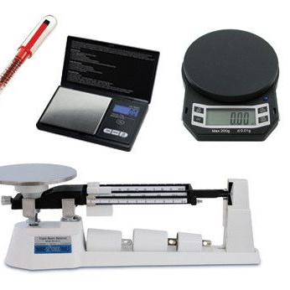
Mastering Maths in GCSE Science
Essential skills for succeeding in Biology, Chemistry, and Physics.

Slide 2
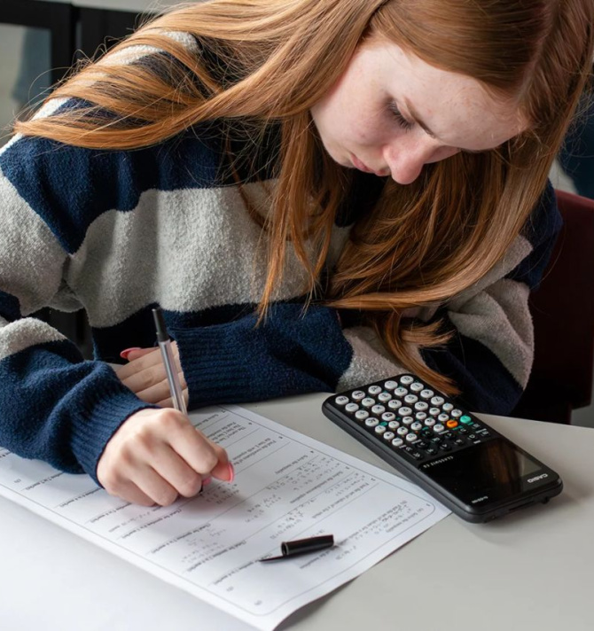
Learning Objectives
By the end of this session, you will be able to:
Rearrange equations using the formula triangle method.
Convert between different units of measurement.
Use the magnification and density formulas correctly in exam scenarios.

Slide 3
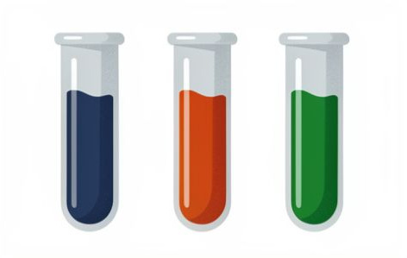
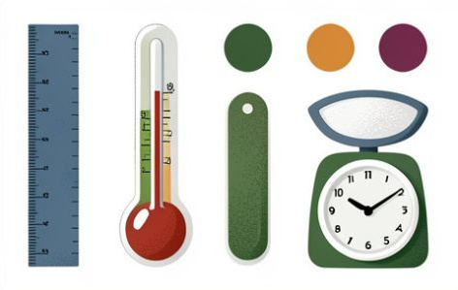

Key Vocabulary
Variable
A factor that can be changed, controlled, or measured in an experiment.
Magnitude
The size or extent of something, represented by a numerical value.
Standard Form
A way of writing very large or small numbers using powers of 10.

Slide 4
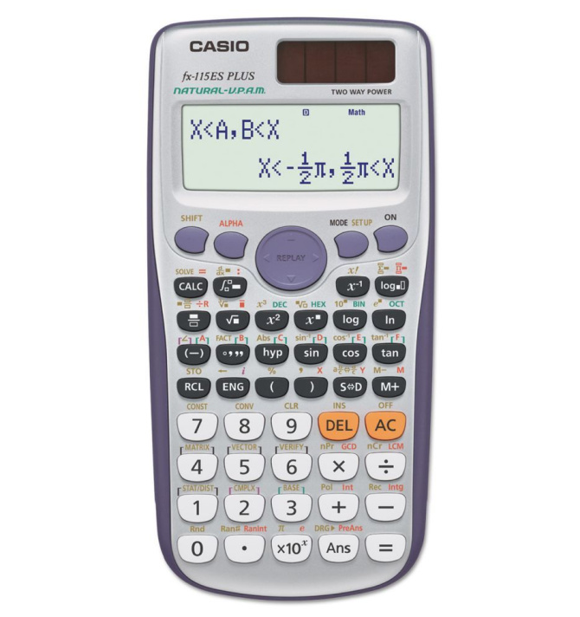
Why do Scientists need Maths?
The Language of Science
Did you know over 30% of GCSE Physics marks are for maths? In Chemistry and Biology, it's 20% and 10%.
Without maths, we couldn't predict stopping distances, medicine doses, or bacterial growth.
🔑
Key point
Calculators are allowed in all GCSE science exams. Know how to use yours before the big day!

Slide 5
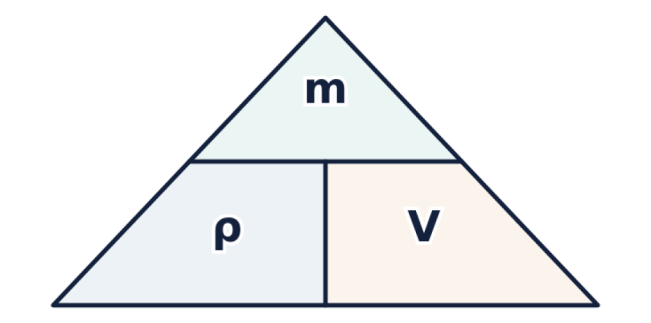
The Art of Rearranging
Science problems provide two values to find a third. Master formula rearrangement.
The Density Formula
Density (ρ) = m ÷ V | m = ρ × V | V = m ÷ ρ
🔍
Example
Object: 200g, 50cm³. Density = 200 ÷ 50 = 4g/cm³.

Slide 6
Rearranging Practice
Answers on the next slide...
If Weight = Mass × Gravitational Field Strength (W = m × g), which equation correctly finds Mass?
1.
m = W × g
2.
m = W + g
3.
m = g ÷ W
4.
m = W ÷ g

Slide 7
Rearranging Practice
✅​
If Weight = Mass × Gravitational Field Strength (W = m × g), which equation correctly finds Mass?
1.
m = W × g
2.
m = W + g
3.
m = g ÷ W
4.
m = W ÷ g
👍​

Slide 8
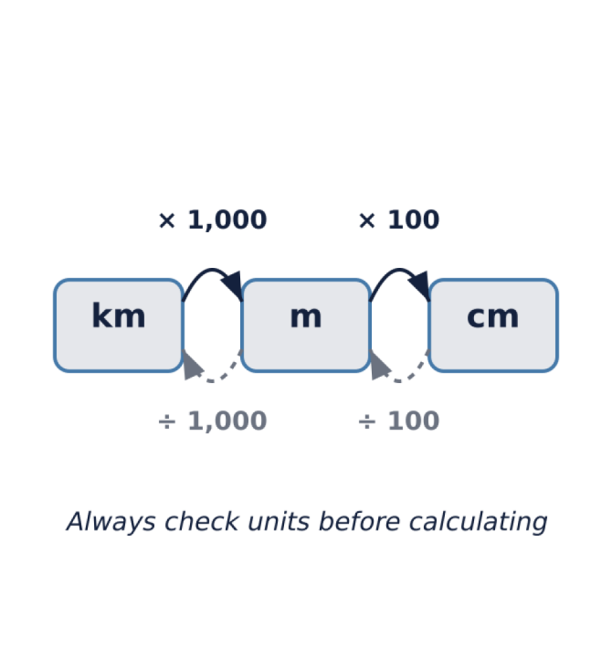
Mastering Units
Units are exam traps. Convert values to match formula requirements before calculating.
Common Conversions:
1 km = 1,000 m
1 m = 100 cm
1 cm = 10 mm
1 min = 60 s
⚠️
Watch out
Check units before calculating. Convert if they don't match the required answer unit.

Slide 9
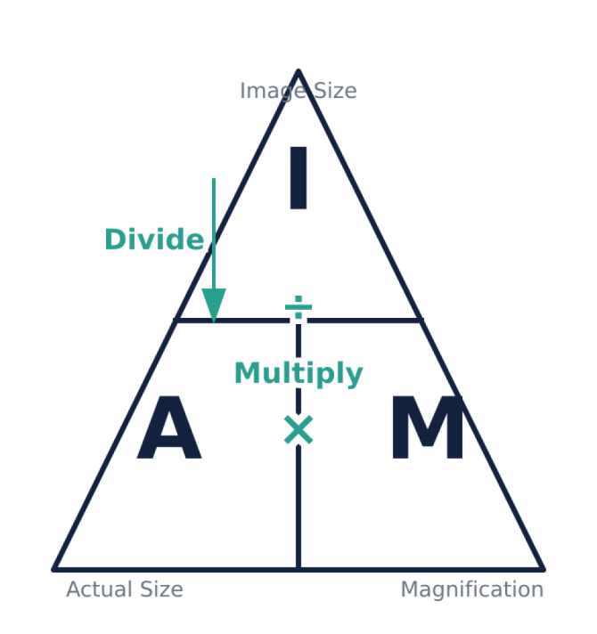
Magnification in Biology
When looking at cells, we use the I AM triangle:
Image Size = Actual Size × Magnification
The Golden Rule
Ensure the Image Size and Actual Size are in the same units (usually micrometres μm) before dividing.
Unit Fact:
1 mm = 1,000 μm

Slide 10
Unit Match-Up
1.
Centimetres to Millimetres
a)
Multiply by 100
2.
Metres to Centimetres
b)
Multiply by 10
3.
Kilograms to Grams
c)
Multiply by 60
4.
Minutes to Seconds
d)
Multiply by 1,000

Slide 11
Unit Match-Up
✅​
1.
Centimetres to Millimetres
b)
Multiply by 10
2.
Metres to Centimetres
a)
Multiply by 100
3.
Kilograms to Grams
d)
Multiply by 1,000
4.
Minutes to Seconds
c)
Multiply by 60

Slide 12

Final Skills Check
Question 1:
A cell has an actual size of 0.02mm. What is this in micrometres (μm)?
Question 2:
Calculate the density of a 100g block with a volume of 20cm³.
Question 3:
If Speed = Distance ÷ Time, how do you calculate Time?
Answers on the next slide...

Slide 13
Final Skills Check
✅​
Answer 1:
20μm
Answer 2:
5g/cm³
Answer 3:
Time = Distance ÷ Speed

