Slide 1
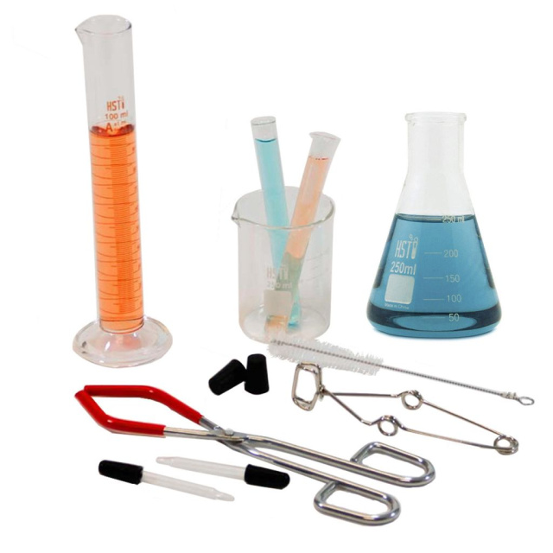
Scientific Variables and Data
Mastering How Science Works

Slide 2

Learning Objectives
Recall and differentiate between independent, dependent, and control variables.
Define continuous, discrete, and categoric data types.
Select appropriate graph types to represent experimental results.

Slide 3

Does the type of ball change how it bounces?
Imagine you are testing the bounce height of a football versus a tennis ball.
What are you specifically changing between each test? And what are you measuring at the end?
🔑
Key point
In any experiment, we must identify what is being manipulated and what the result is.

Slide 4
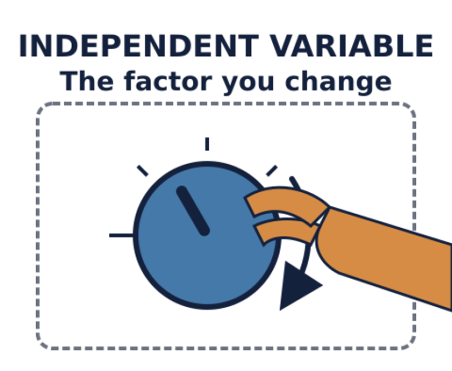
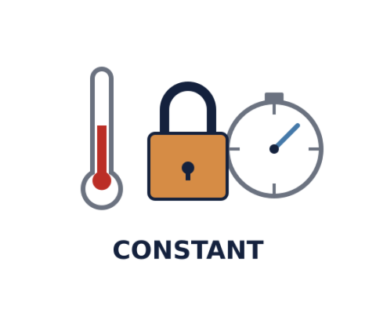
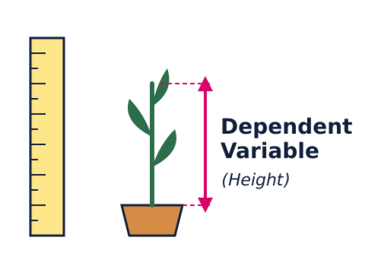
The Three Key Variables
KEY CONCEPT
Independent
The variable you change. The cause in your experiment.
Dependent
The variable you measure. It changes based on the independent.
Control
Factors kept constant. These ensure the test is fair.

Slide 5

The Importance of Control
Without control variables, your results are invalid.
If you test who has a better attention span (boys vs girls) but you distract the girls with loud music and leave the boys in silence, your data tells you nothing about gender—it only tells you about noise.
🧠
Remember
A 'fair test' is one where only the independent variable is changed.

Slide 6

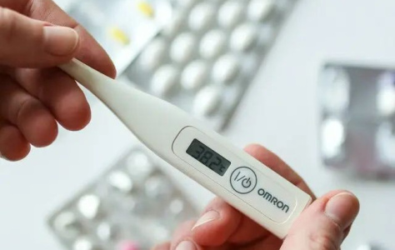

Classifying Scientific Data
VOCABULARY
Discrete: Only whole numbers (e.g., number of paperclips or people).
Continuous: Any value on a scale (e.g., length, temperature, time).
Categoric: Values described by labels or words (e.g., colours, metal types).

Slide 7
Data Definitions Match
1.
Categoric
a)
Data that can only be whole numbers like counts of objects.
2.
Variable
b)
Any factor that can change or be changed in an experiment.
3.
Discrete
c)
Data that is described by words or labels.
4.
Continuous
d)
Data that can be any decimal value like mass or length.

Slide 8
Data Definitions Match
✅​
1.
Categoric
c)
Data that is described by words or labels.
2.
Variable
b)
Any factor that can change or be changed in an experiment.
3.
Discrete
a)
Data that can only be whole numbers like counts of objects.
4.
Continuous
d)
Data that can be any decimal value like mass or length.

Slide 9
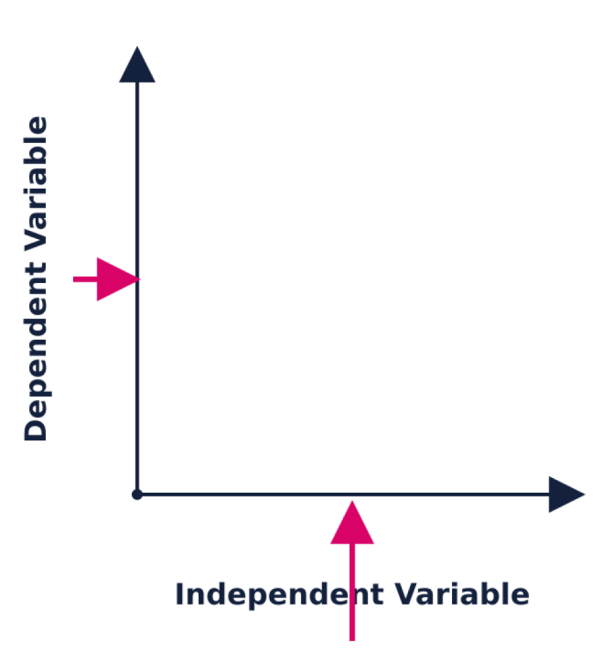
Choosing the Right Graph
How to decide:
Use a Line Graph if the independent variable is continuous (e.g. temperature vs growth).
Use a Bar Chart if the independent variable is categoric (e.g. material vs heat conduction).
🔑
Key point
The independent variable always goes on the X-axis (bottom), and the dependent variable goes on the Y-axis (side).

Slide 10
Graph Selection Check
Answers on the next slide...
Which graph should you use to show how the type of battery affects the brightness of a bulb?
1.
Scatter Graph
2.
Bar Chart
3.
Line Graph
4.
Pie Chart

Slide 11
Graph Selection Check
✅​
Which graph should you use to show how the type of battery affects the brightness of a bulb?
1.
Scatter Graph
2.
Bar Chart
👍​
3.
Line Graph
4.
Pie Chart

Slide 12

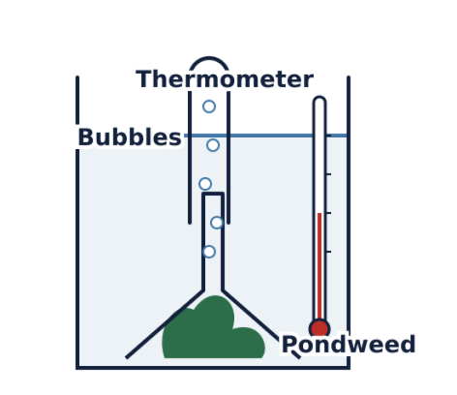
Final Challenge: Pondweed Experiment
A student investigates how water temperature affects the number of bubbles released by pondweed.
Identify the independent and dependent variables.
List two control variables.
State whether the results should be plotted on a line graph or a bar chart and justify why.

